Slide 1
Disc Plow
Compile By: Guiller B. Damian

Slide 2
DEFINITIONS
For the purpose of this standard, the following definitions shall apply:
3.1 concave disc
Circular concave steel plate used for cutting and inverting the soil
3.2 concavity
Vertical distance measured from the lowest point to the center of the disc when its concave side is placed on a flat surface
3.3 disc plow
Implement with individually mounted concave disc blades which cut, partially or completely invert soil slices to bury surface material, and pulverize the soil

Slide 3
3.4 frame
Structure on which the standards are fitted (see Figure 1)
3.5 hitch
Portion of an implement designed to connect the implement to a power source (see Figure 1)
3.6 scraper
Component which scrapes the soil adhering to the concave side of the disc (see Figure 1)

Slide 4
3.7 side angle
Disc angle, in the soil surface plane, between a tool axis and a line, which is perpendicular to the direction of travel (see Figure 2)
3.8 standard
Beam upright support which connects the shank to tillage implement frame (see Figure 1)

Slide 5
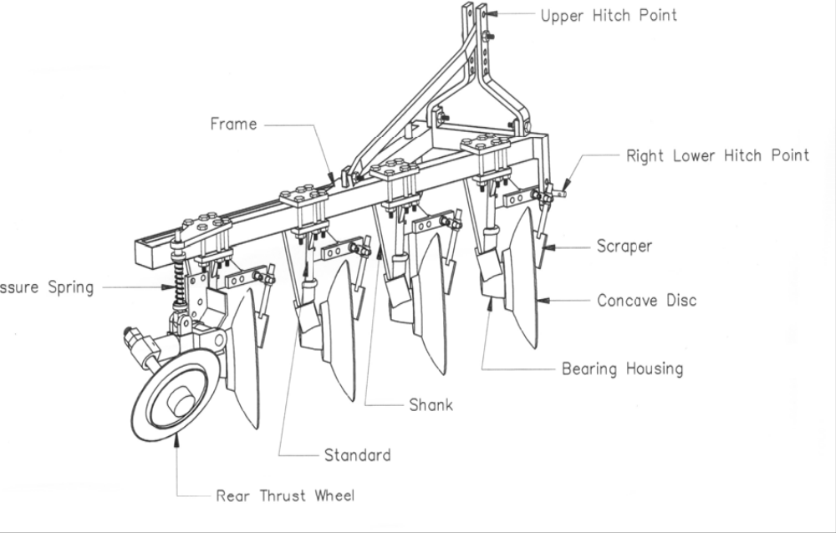
Figure 1. disc plow and components

Slide 6
3.9 Tilt angle
Angle, in a vertical plane perpendicular to the direction of travel, between a tool axis and the soil surface (see Figure 2)
3.10 Width of cut
Transverse distance between either the top or bottom cutting edges of the end discs
NOTE: For measuring the width of cut, the tilt angle shall be set at 15 to 25°. For nonadjustable plow disc blades, the tilt angle shall be set at 18 to 20°.

Slide 7
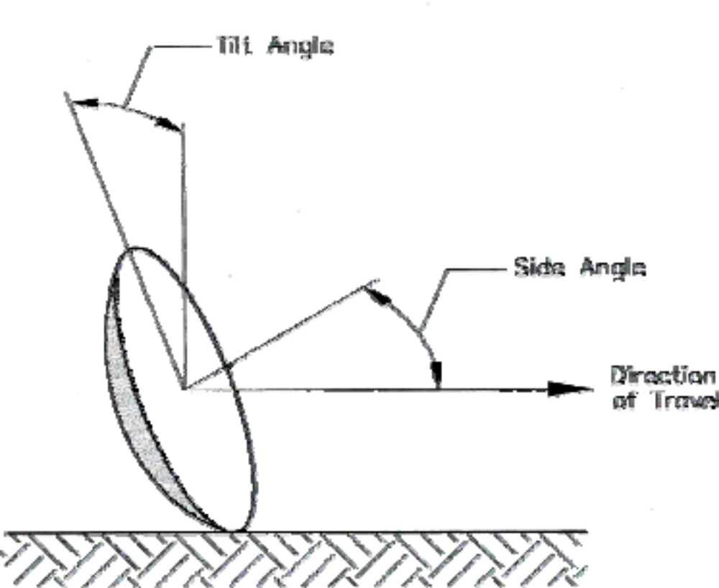
Figure 2 – Disc and Tilt Angle

Slide 8
CLASSIFICATIONS
One-way Disc Plow
Reversible Disc Plow
    Tractor-mounted Reversible Disc Plow
    Semi-mounted Reversible Disc Plow

Slide 9
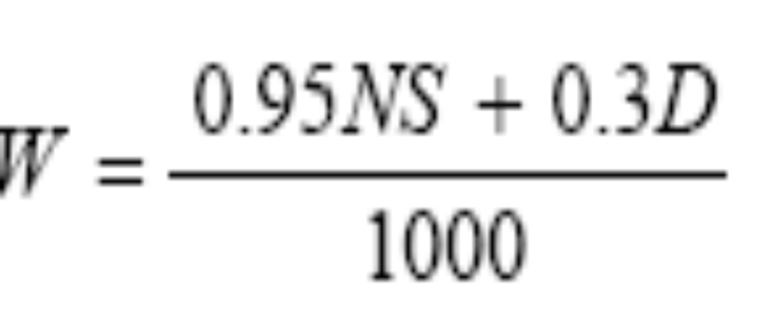
SIZE
The size of the plow shall be determined by the number and diameter of the discs and the width of cut. For size determination, width of cut shall be calculated by the following formula:

Slide 10
MATERIALS OF CONSTRUCTION
Mild steel shall be used in the manufacture of the frame, scraper, thrust wheel and hitch.
Cast iron shall be used in the manufacture of spool.
Carbon steel shall be used in the manufacture of hitch pin.
Carbon steel with at least 80% carbon content (e.g. AISI 1080) or alloy steel with at least 0.0005% boron content shall be used in the manufacture of the disc blades.
High carbon steel shall be used in the manufacture of standard.

Slide 11
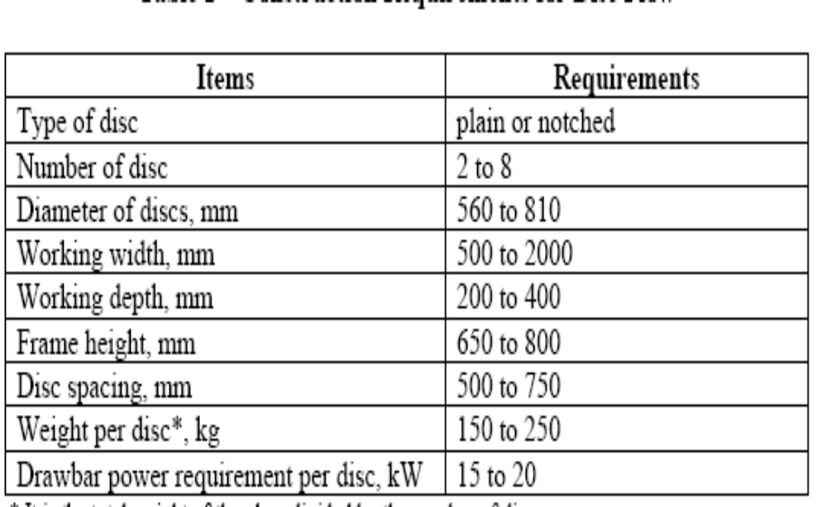
CONSTRUCTION REQUIREMENTS
Table 1 – Construction Requirements for Disc Plow

Slide 12
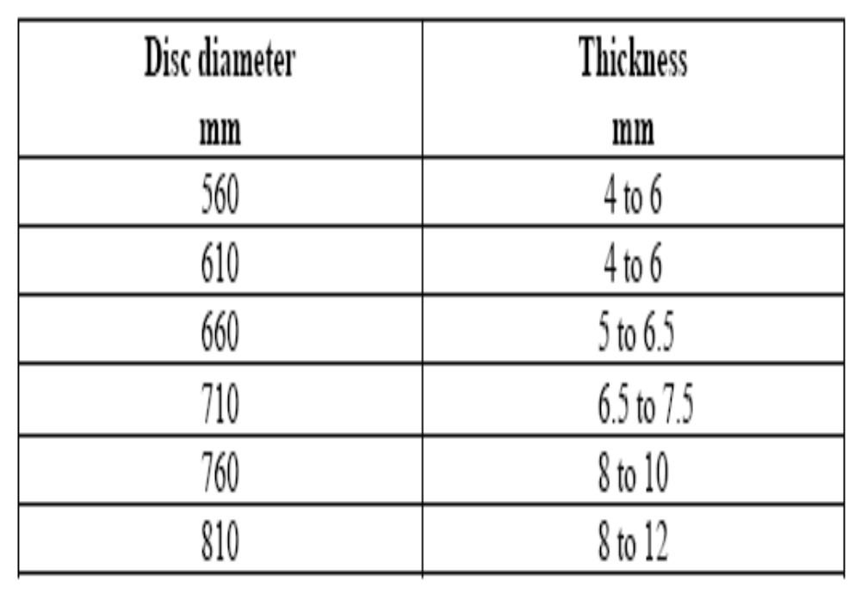
Table 2 – Disc Diameter and its Thickness

Slide 13
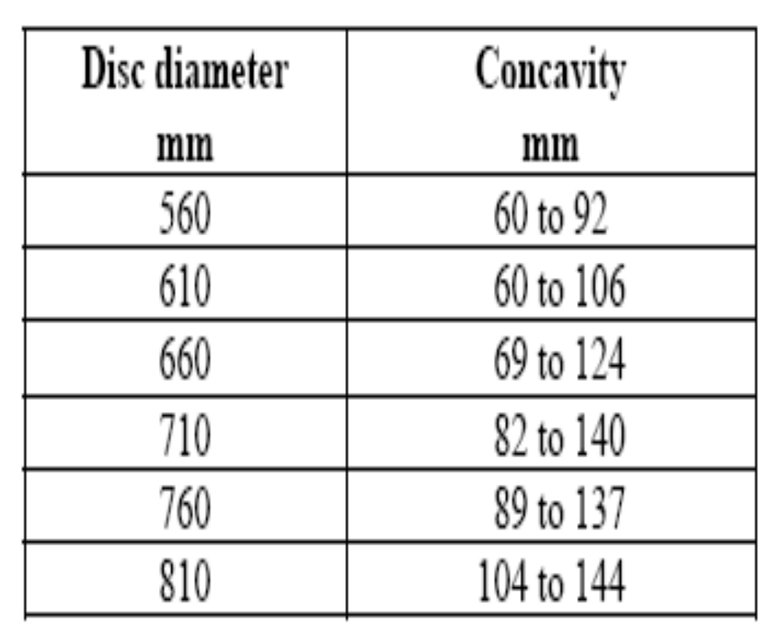
Table 3 – Disc Diameter and its Concavity

Slide 14
OPERATIONS IN AGRICULTURAL PRODUCTION
Land Preparation
Land clearing
land forming/ridge forming
Plowing
Harrowing
Leveling
Planting/Transplanting
Broadcasting
Pulling of seedlings
Transplanting
Parachuting

Slide 15
Crop Care
  Irrigation
  Cultivation
  Trimmings
  Weeding
  spraying (Fertilizer/insecticide/
  pesticide application)
  Harvesting
  Manual
  Mechanical
  Threshing
  Manual
  Mechanical
  Drying
  Manual
  Mechanical
  Milling
  Manual
  Mechanical
Others
Shelling
Grading
Shredding
Mixing
Chopping
Cutting

Slide 16
DESIGN CRITERIA
Cost
Durability
Ease of operation/Ergonomics
Availability of spare parts
Training Support
Safety

Slide 17
APPROACH TO AMD
Know and review present design
Adopt good features of existing design
Determine design requirements
Determine design data
Design concept

Slide 18
Technical drawings
Materials and specification
Fabrication
Testing and evaluation

Slide 19
Testing and Evaluation
Technical aspects
Financial aspects
Social aspects
Institutional aspects
Environmental aspects

Slide 20
Product Dissemination
Product knowledge
Product promotion/Demo
Marketing
Feedbacks/Mechanism
Product improvements

Slide 21
Category of Resources for Agricultural Machinery Design
Human Resources
Power Sources
Tools and Equipment
Instrumentation
Materials for construction/Hardwares
Time

Slide 22
Philippine Agricultural Engineering Standards (PAES)
TEST CODE AND EVALUATION

Slide 23
SPECIFICATIONS
Scope
References
Definitions
Physical description and constructions
Figures showing the different parts
Performance and other requirements
Workmanship and finish
Warranty for construction and durability
Maintenance and operation
Packaging, marking and labeling

Slide 24
METHOD OF TEST
Scope
Verification of the Specifications
Test and inspections
Laboratory Performance Test
Field Performance Test
Operator’s Safety
Inspection and Performance Record Sheet

Slide 25
TEST REPORT FORMAT
Name of testing agency
Test report number
Title
Summary
Purpose and scope of test
Methods of test
Conditions of the machine

Slide 26
Figures
Table of specifications
Results of test
Other observations
Names and signatures of test Engineers

Slide 27
Grain seeder
Seeder is a planting equipment used to deposit seeds in the soil for crop production
It can be a manually-operated, animal-drawn or tractor power-driven seeder

Slide 28
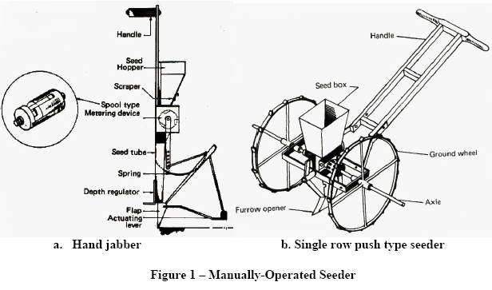
CLASSIFICATION OF SEEDER AND PLANTER
Manually-operated or hand seeder
This is a type of seeder which deposits the seeds in holes with spacing set by the operator

Slide 29
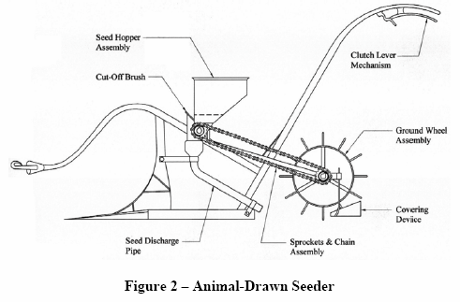
Animal-drawn seeder

Slide 30
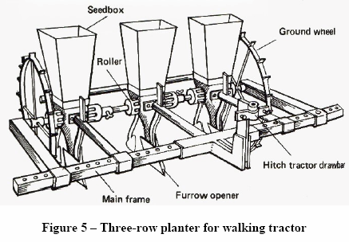
Tractor power-driven seeder and planter
This is a type of seeder with metering mechanisms driven by the ground wheels or by power take-off from a tractor

Slide 31
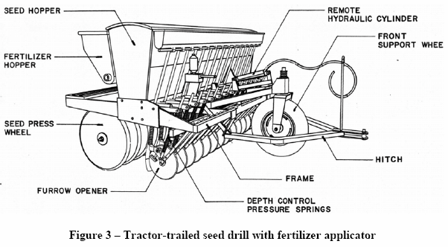
Seed drill
This is a type of tractor power-driven seeder which drills and deposits the seeds at a specified rate and depth and in narrow-spaced rows. It cannot deposit the seeds in hills or even in check rows.

Slide 32
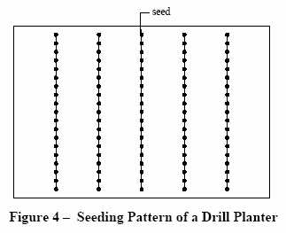

Slide 33
Hill-drop planter
This is a type of row-crop planter which is designed to deposit one or more seeds in a hill at equal intervals.

Slide 34
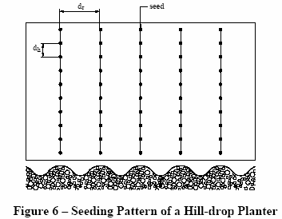
NOTE dr is the distance between rows
dh is the distance between hills at equal intervals
dr is not equal to dh

Slide 35
Checkrow planter
This is a type of row-crop planter which enables operator to perform hill planting at definite spacing (in checks or squares). This facilitates mechanical weed control and other operations.

Slide 36
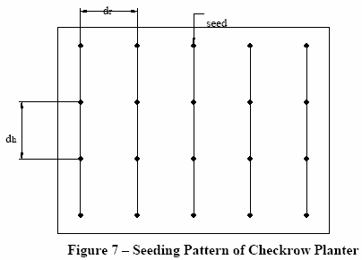
NOTE dr is the distance between rows
dh is the distance between hills at equal intervals
dr is equal to dh

Slide 37
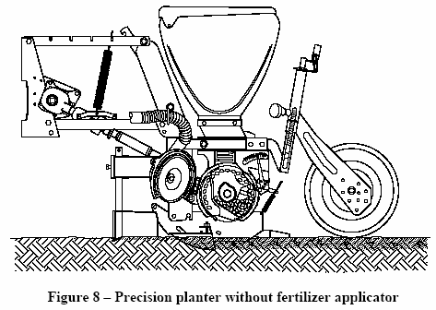
Precision planter
This is a type of row-crop planter which is designed to deposit a single seed at equal row intervals

Slide 38
Materials of Construction
The seeder and planter shall be generally made of steel and/or plastic.

Slide 39
Construction Requirements
The seed plate shall be replaceable.
Seeders shall be provided with control to adjust seed depth.

Slide 40
Hoppers shall be designed to contain seed/fertilizer with minimum frequency of refilling during operation.
Multi-row seeder shall have
  adjustable row spacing
  independent suspension for each row planter

Slide 41
For four-wheel tractor mounted/trailed seeders, these may be provided with seed drop sensors and monitor.
For seeder with fertilizer applicator, it shall be
  provided with adjustable fertilizer metering and depth of delivery control
  designed to place the seed and fertilizer so they will not be in contact with each other.

Slide 42
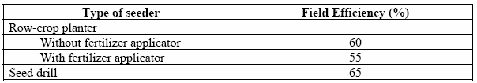
Required Minimum Efficiency for Tractor Power-Driven Seeder

Slide 43
Must be determined
field efficiency - ratio of effective field capacity to the theoretical field capacity.
effective field capacity - actual rate of being able to plant a given area per unit of time.
theoretical field capacity - computed rate of being able to plant a given area per unit of time.
seed delivery rate - amount of seeds that can be planted per unit area.
fuel consumption - volume of fuel consumed by the engine on per hour basis.

Slide 44

wheel slip of seeder or planter
this is determined by the following formula:
where:
N1 is the sum of the revolutions of all driving wheels for a given distance with slip, rpm
N0 is the sum of the revolutions of all driving wheels for the same distance without slip, rpm

Slide 45
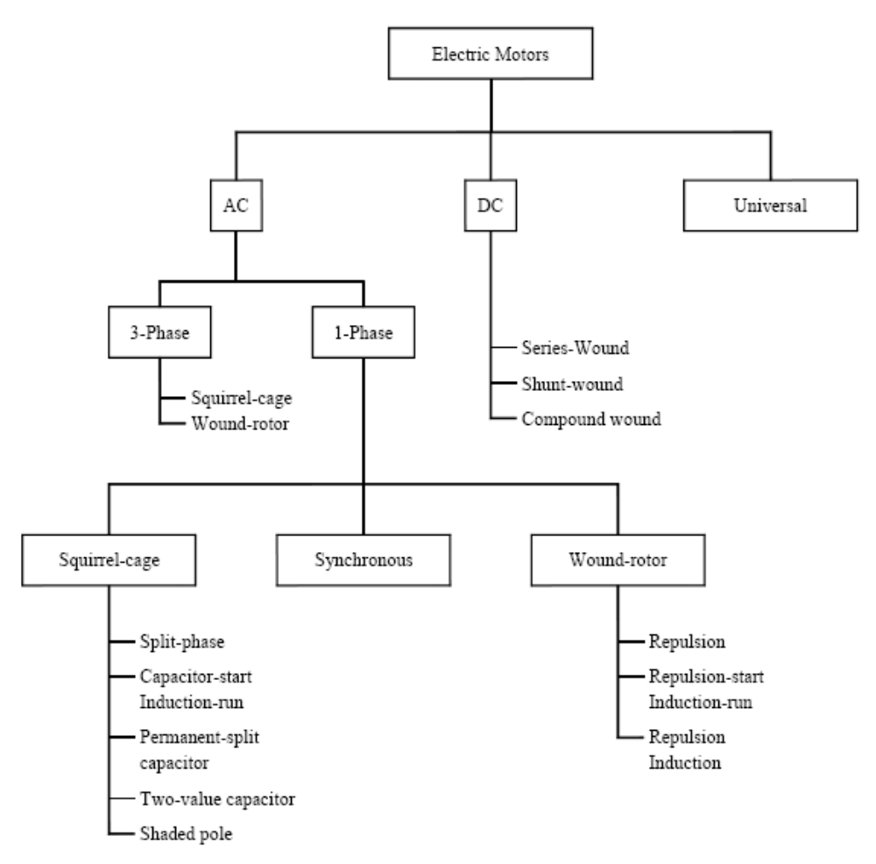

Slide 46
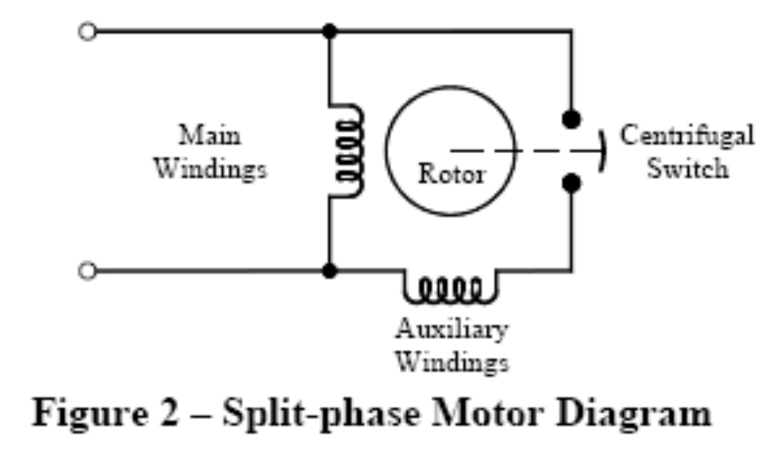
STARTING

Slide 47
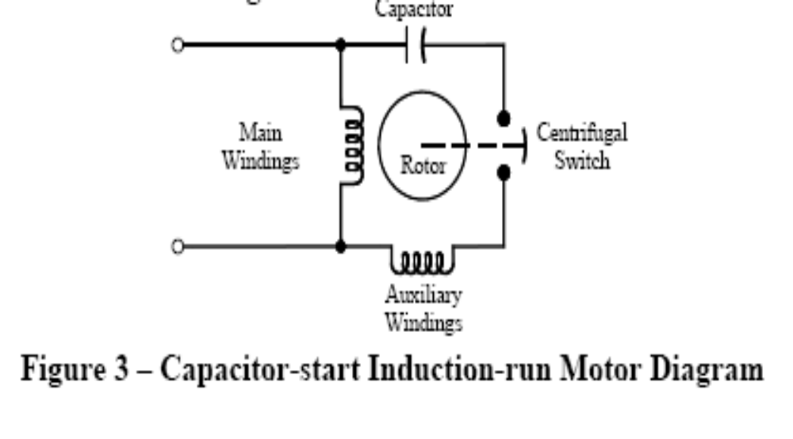

Slide 48
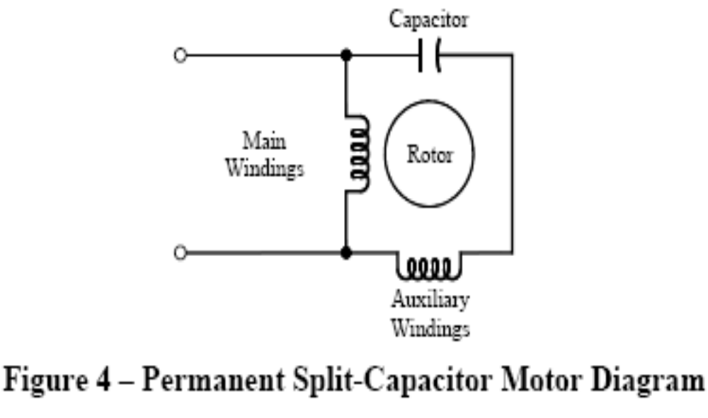

Slide 49
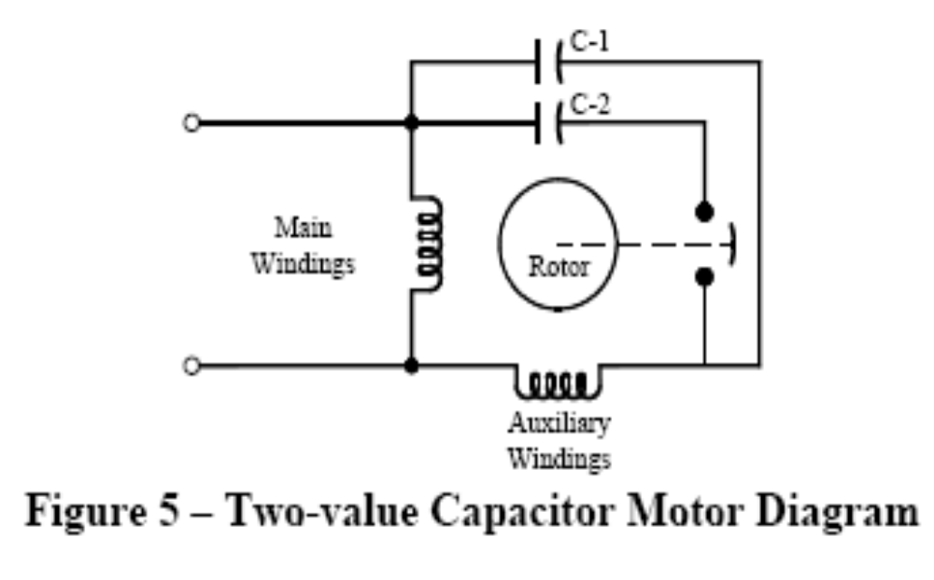

Slide 50
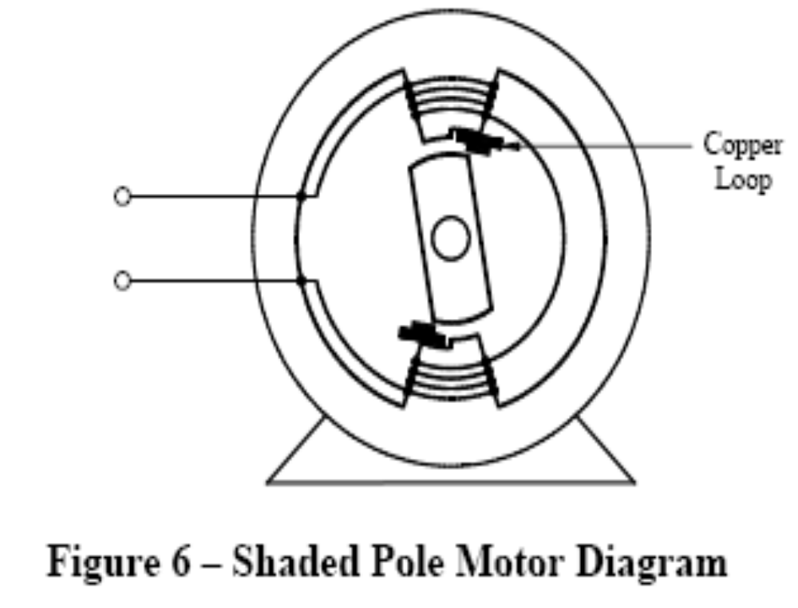

Slide 51
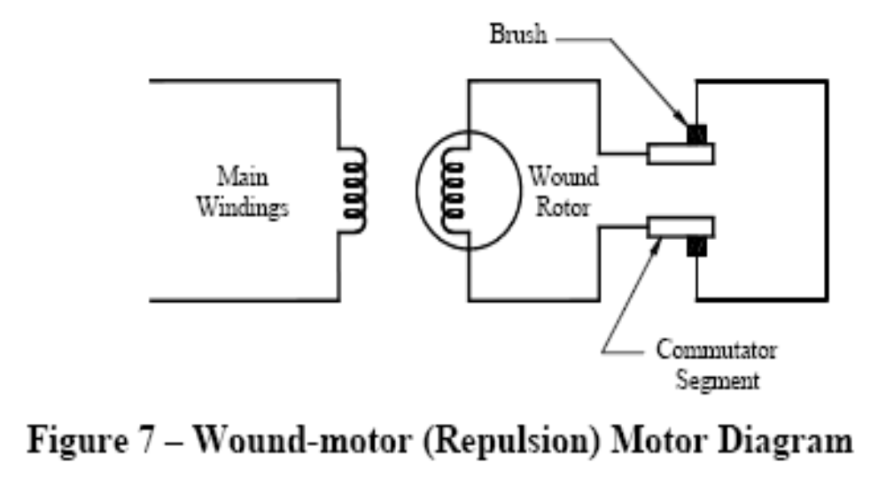

Slide 52
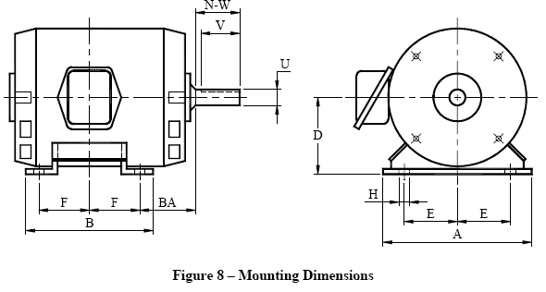
Mounting

Slide 53
Varying load test
Output power, P_{o}, (kW)
P_{o} = T x N/974
Where:
T is the shaft torque, kg-m
N is the shaft speed, rpm

Slide 54
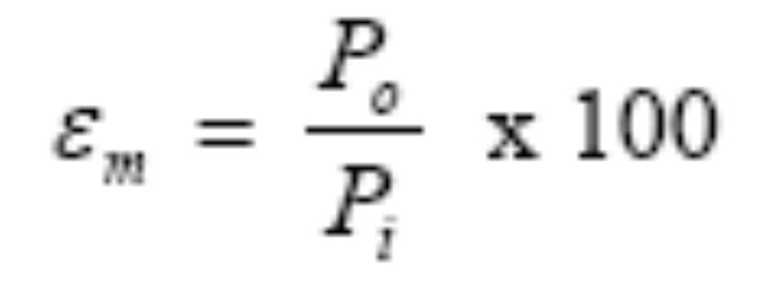
Motor Efficiency, εm, (%)
where:
Po is the shaft output power, kW
Pi is the input power, kW

Slide 55
FOUR WHEEL TRACTOR

Slide 56
Classification
Two wheel Drive
Four wheel drive

Slide 57
Hydraulic Lift Force Capacity
Maximum drawbar power kW | Lift force per drawbar power
65 and below | 0.31
Above 65 | 20.15 plus 0.155 kN/kW for the succeeding drawbar power

Slide 58
Laboratory Performance Tests
PTO performance test
- Test conditions
- Maximum power test
- Test at full load and varying speed
- Test at varying load

Slide 59
Hydraulic lifting force and power
Test conditions
Lifting Force
- Lift at lower hitch points
- Lift on a coupled frame
Hydraulic power

Slide 60
Drawbar power
Test conditions
- Tire sizes
- Test track
- General Requirements
Drawbar power test, unballasted tractor
Drawbar power test, ballasted tractor
Five-hour test
Ten hour test for the special case of track laying tractors

Slide 61
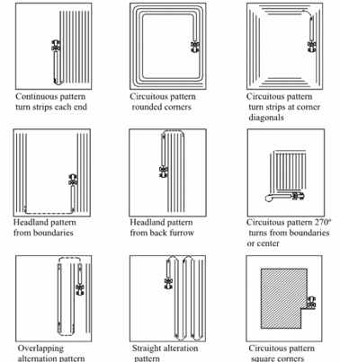
Field operational pattern

Slide 62
Measurement
Operating Speed
Noise level measurement
Fuel Consumption

Slide 63
Average swath or width of cut, S, (m)
S=W/2n
Where:
W is the width of plot, m
n is the number of rounds
2 is the number of trips per round

Slide 64
Total distance traveled, D, (m)
A = L x W
Where:
A is the area of plot, m2
L is the length of the plot, m

Slide 65
Effective area accomplished, Ae, (m2)
Ae = wD = 2nLw
Where:
w is the width of plow or rotary tiller, m

Slide 66
If width of swath is less than the plow’s or rotary tiller’s width, the operator has passed over part of the area twice to secure better coverage, therefore:
Ao = Ae - A
Where:
Ao is the overlap (area which is plowed or rototilled twice), m2

Slide 67
If the average width of swath is greater that the plow’s or rotary tiller’s width, the operator has left part of the area unplowed or unrototilled, therefore:
Au = A - Ae
Where:
Au is the unplowed or unrototilled area (area missed), m2

Slide 68

Effective field capacity, efc, (m2/h)
Where:
t is the time used during the operation, min

Slide 69
Theoretical Field Capacity, tfc, (m2/h)
tfc=we x v
Where:
we is the effective or theoretical width of tillage, m
v is the speed of operation, m/h

Slide 70

Field Efficiency, Feff, (%)

Slide 71

Fuel Consumption, FC, (L/h)
Where:
V is the volume of fuel consumed, L
t is the total operating time, h

Slide 72

Wheel slip, %
Where:
N0 is the sum of the revolutions of all driving wheels for the
same distance without load, rpm
N1 is the sum of the revolutions of all driving wheels for a
given distance with load, rpm

Slide 73
Axle/Rotary Shaft Torque, T, (kg-m)
T= F x L
Where:
F is the axle or rotary shaft load, kg
L is the length of pony brake arm, m

Slide 74

Axle/Rotary Shaft Power, P, (kW)
Where:
Ft is the total axle or rotary shaft load, kg
N is the speed of axle or rotary shaft, rpm

Slide 75
Specific fuel consumption, SFC, (g/Kw-h)
SFC = F_{c} x P_{f}
P
Where:
Fc is the fuel consumption, L/h
p_{f is the density of fuel, g/l}
P is the axle or rotary shaft power

Slide 76
DEFINITIONS
LEVER-OPERATED KNAPSACK SPRAYER (LOKS)-BACKPACK SPRAYER
sprayer which is operated manually with a lever and can be carried on the back of an operator for spraying
PRESSURE CHAMBER
component of the sprayer that evens out the fluctuations of the fluid pressure and induces
more uniform flow of the sprayed liquid
TANK CAPACITY
maximum allowable volume of the liquid to fill the sprayer tank, when equipped with all its internal mountinglever-operated knapsack sprayer (LOKS)

Slide 77
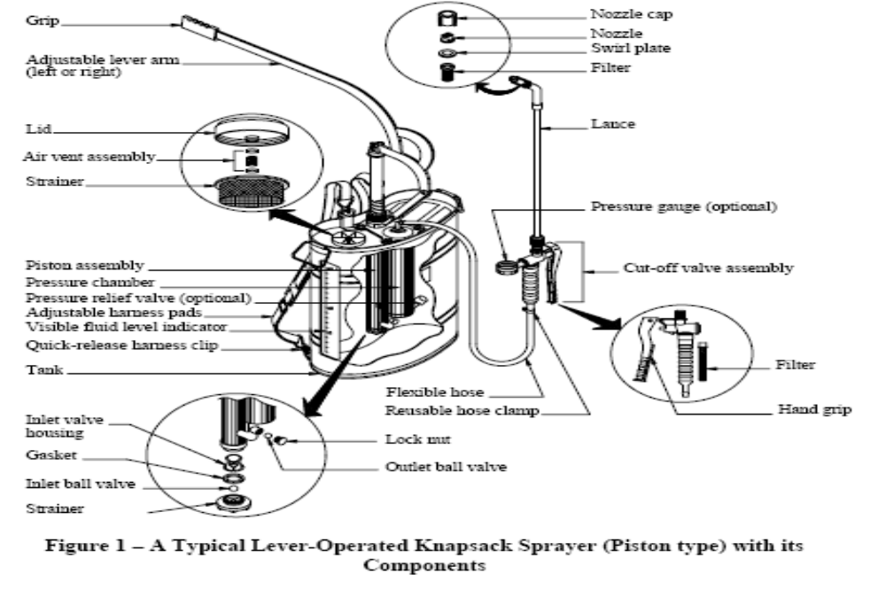
PHYSICAL DESCRIPTION AND CONSTRUCTION

Slide 78
REQUIREMENTS
Tank
1 The tank shall have a minimum capacity of 10 liters.
2 The overall weight of the sprayer with its component parts, when fully loaded with water shall not exceed 22 kgs.
3 The sprayer shall remain upright and stable when placed on a level surface. It shall be easy for the user to lift the sprayer at full tank and its components onto the back.
4 It should be possible to empty the tank completely during spraying, and in no case shall there be more than 50 ml of residue after system pump out.
5 The sprayer shall withstand standard drop test when tested in accordance with PAES 113.

Slide 79
REQUIREMENTS
General
Tank
Pump and Lever
Filter Assembly
Filling Hole
Hose and Lance
Cut-off Valve Assembly
Nozzle Assembly
Strap

Slide 80
REQUIREMENTS
Connectors and Fasteners
Pressure Regulation (optional)
Pressure gauge (Optional)
Fluid Level Indicator
Warranty for Construction and Durability
Maintenance and Operation
Sampling
Test Method
Packaging , Marking and Labeling

Slide 81
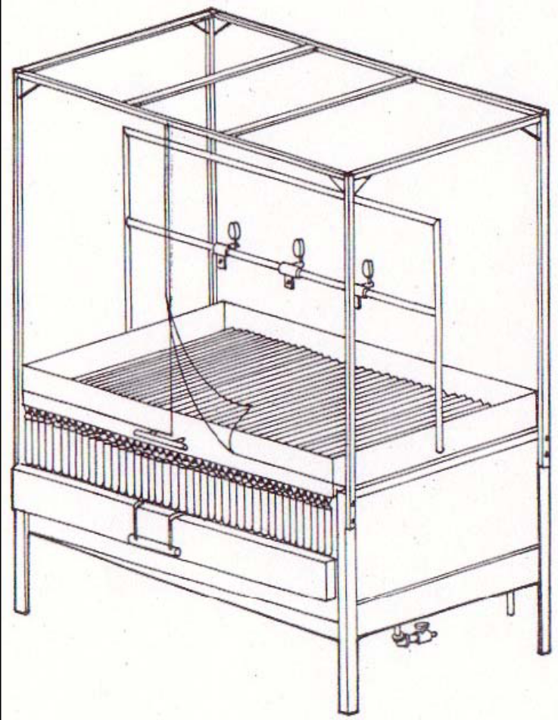
PATTERNATOR

Slide 82
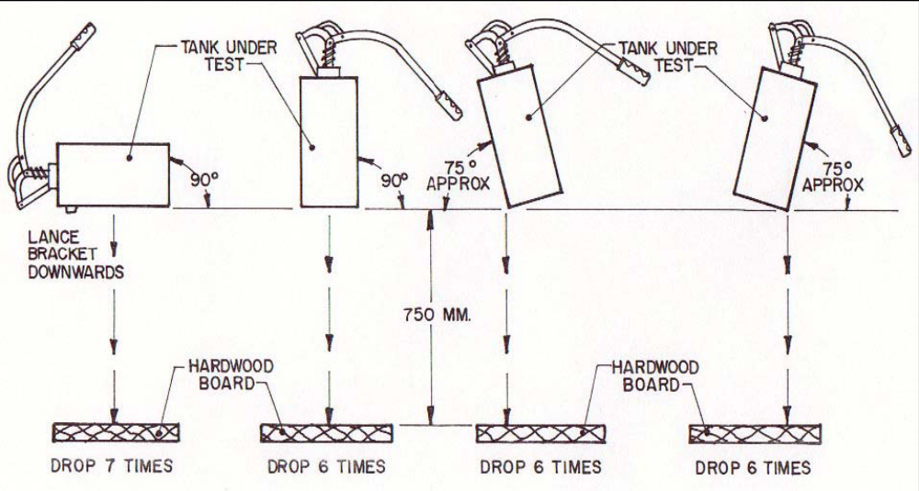
DROP TEST

Slide 83
Disc harrow
implement used to pulverize the soil to attain a better soil tilth for the seed germination and growth.

Slide 84
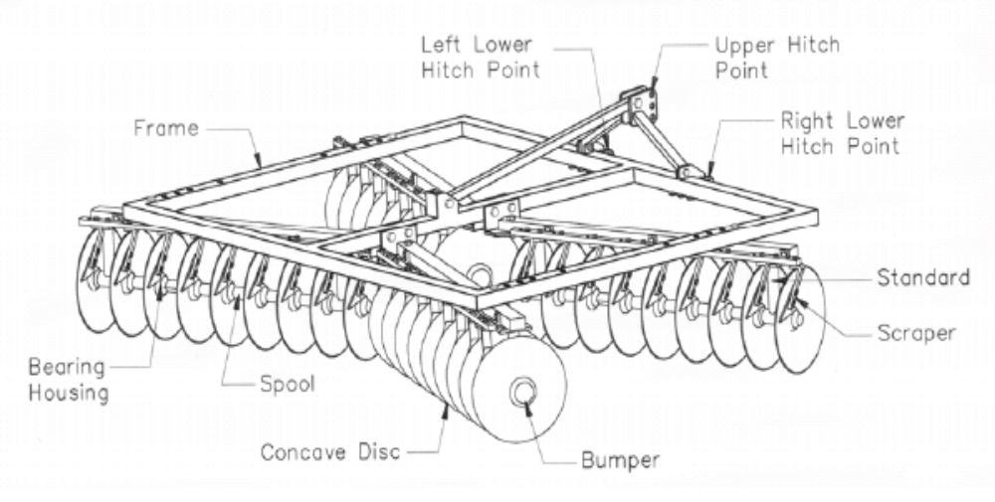
Disc Harrow and its Components

Slide 85
Definitions
Concave disc - circular concave steel plate used for cutting and inverting the soil
Disc spacing – transverse distance between two adjacent disc edges
Frame - structure on which the gangs are fitted (see Figure 1)

Slide 86
Gang - set of concave discs, which is mounted on a common shaft and separated by a spool
Gang angle - angle between the axis of gang and the line perpendicular to the direction of motion
Gang angling mechanism - mechanism by which the gang angles are adjusted

Slide 87
Gang axle - shaft on which a set of concave discs are fitted
Ground clearance - vertical distance between the ground and the lowest edge of the disc when the trailed harrow is supported on transport wheels
Hitch - portion of an implement designed to connect the implement to the power source (see Figure 1)

Slide 88
Included angle - angle between the axes of two adjacent gangs
Scraper - component which scrapes the soil adhering to the concave side of the disc (see Figure 1)
Side angle - disc angle, in the soil surface plane, between a tool axis and a line, which is perpendicular to the direction of travel (see Figure 2)

Slide 89
Spool - flanged tube mounted on gang axle and placed between two discs to prevent the lateral movement of the discs on the shaft (see Figure 1)
Width of cut - transverse distance between the top or bottom cutting edges of the end discs

Slide 90
Single-action disc harrow - consists of two gangs of discs, placed end-to-end at an angle, which throw the soil in opposite directions
Tandem disc harrow - consists of two or more gangs, in which a set of two gangs follows behind the front gangs and is arranged in such a way that the discs on the front gangs throw the soil in one direction (usually outward) and the discs on the rear gangs throw the soil in the opposite direction

Slide 91
Offset disc harrow -consists of two gangs wherein one gang is located behind the other at an angle and the harrow is operated in an offset position in relation to the tractor centerline

Slide 92
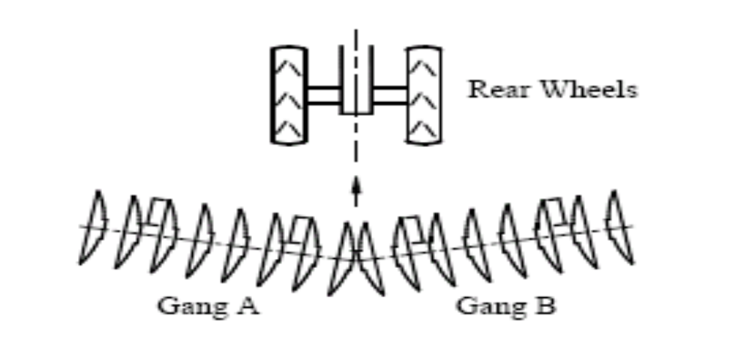
Classification
According to gang orientation
Single-action

Slide 93
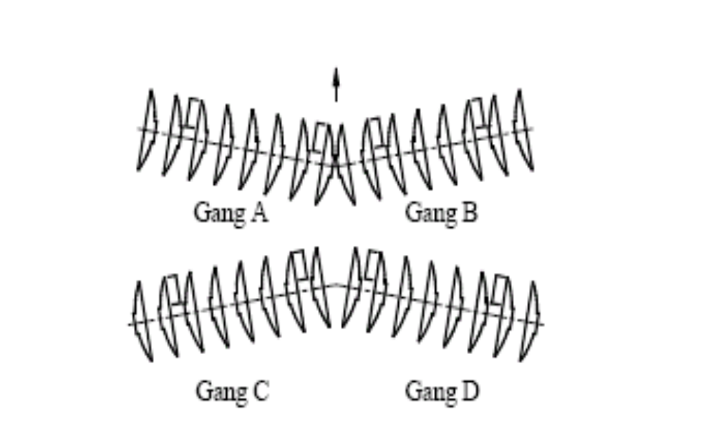
Tandem

Slide 94
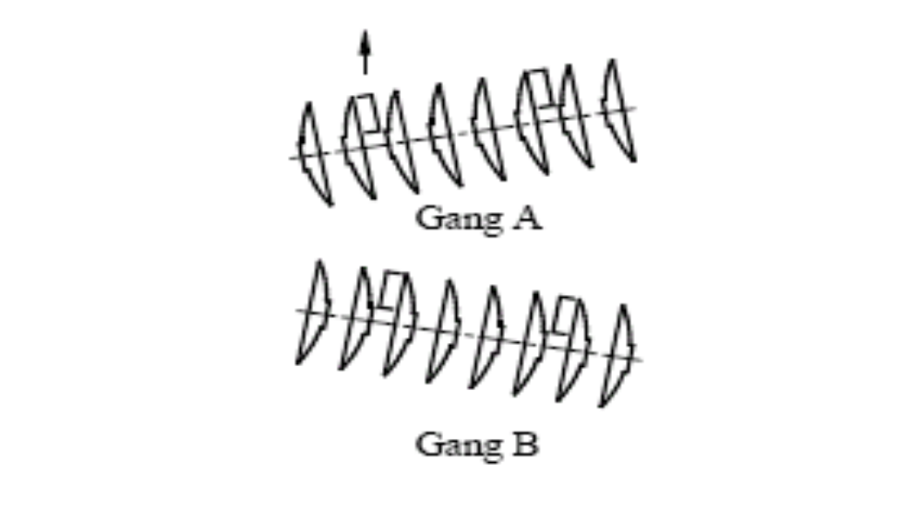
offset

Slide 95
According to manner of hitching to the tractor :
Tractor-mounted disc harrows

Slide 96
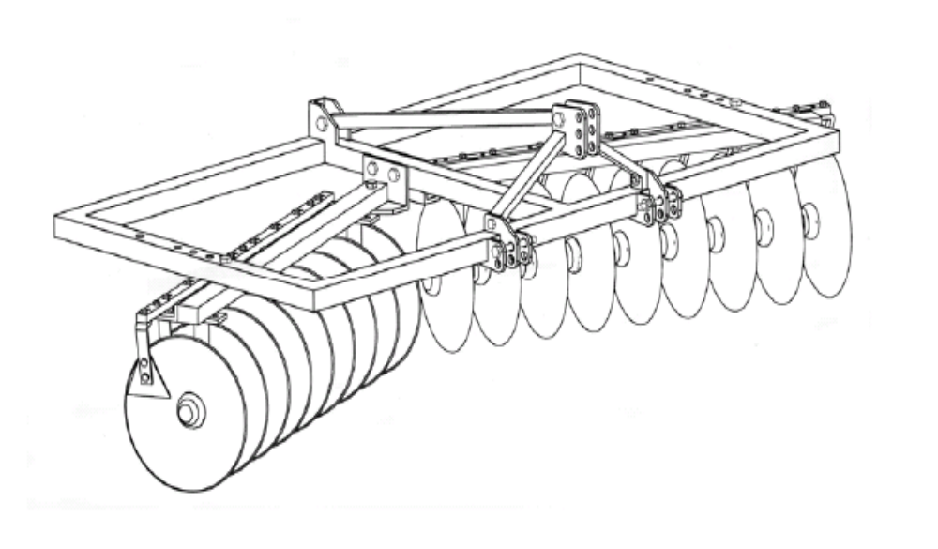
Tractor-mounted
single-action disc harrow

Slide 97
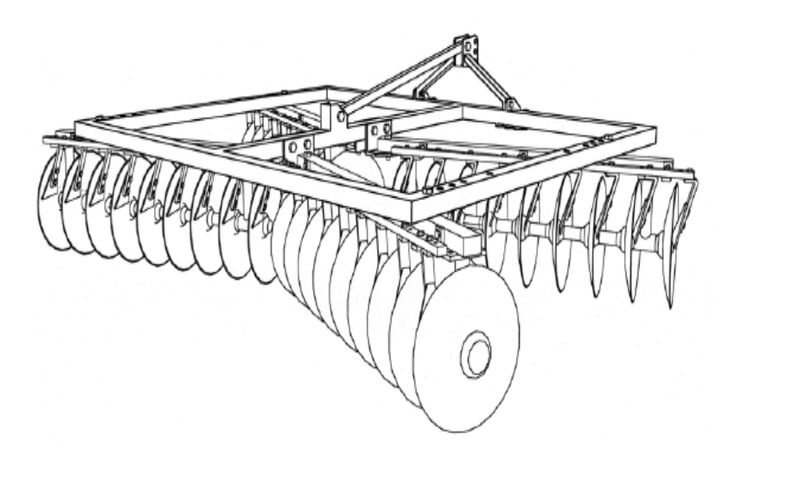
Tractor-mounted tandem disc harrow

Slide 98
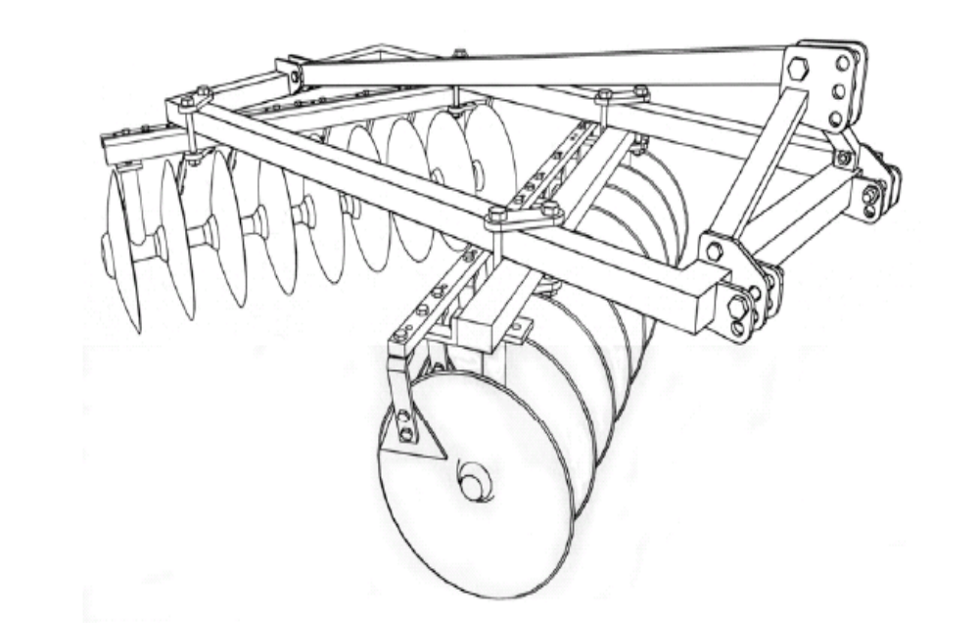
Tractor-mounted offset disc harrow

Slide 99
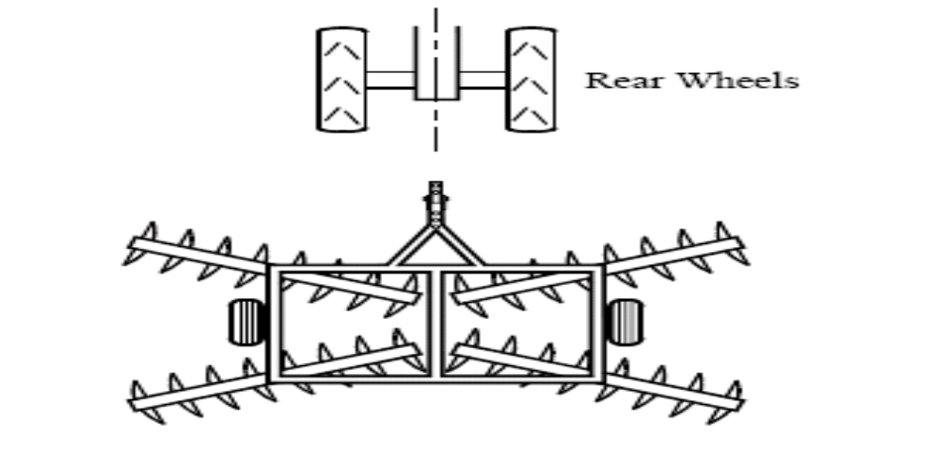
Trailing disc harrows
trailing tandem disc harrow

Slide 100
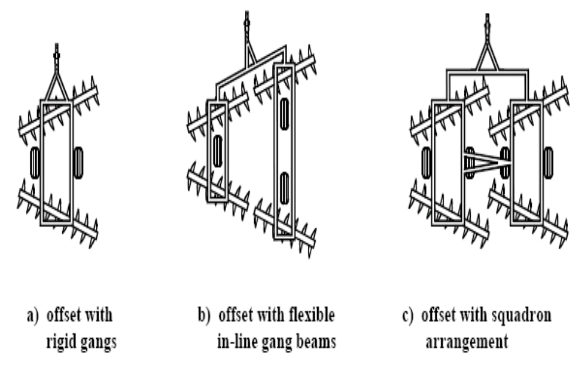
trailing offset disc harrows

Slide 101
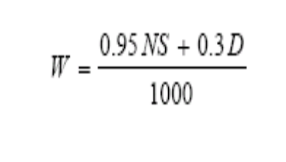
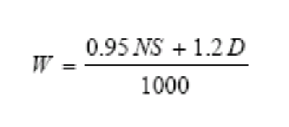
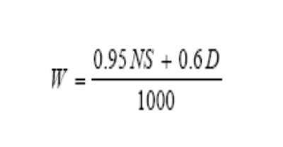
Size
The size of the harrow shall be determined by the number and diameter of the discs and the width of cut. For size determination, width of cut shall be calculated by the following formula:
  a) For single-action :
  b) For tandem type:
  c) For offset type:

Slide 102
Materials of Construction
Mild steel shall be used in the manufacture of the frame, gang axle, scraper, gang angling mechanism, and hitch.
Cast iron shall be used in the manufacture of spool.
Carbon steel shall be used in the manufacture of hitch pin. Carbon steel with at least 80% carbon content (e.g. AISI 1080) or alloy steel with at least 0.0005% boron content shall be used in the manufacture of the disc blades.

Slide 103
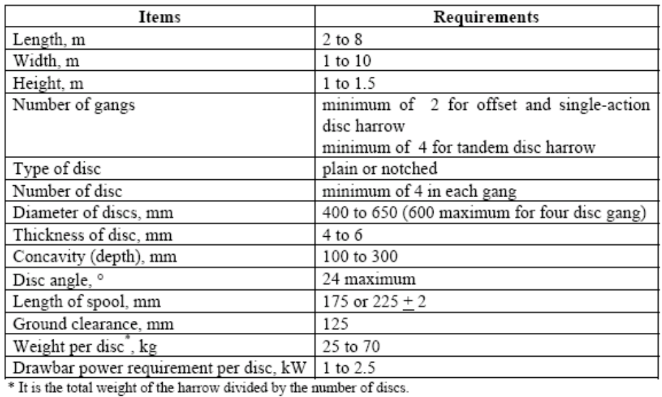
Construction Requirements

Slide 104
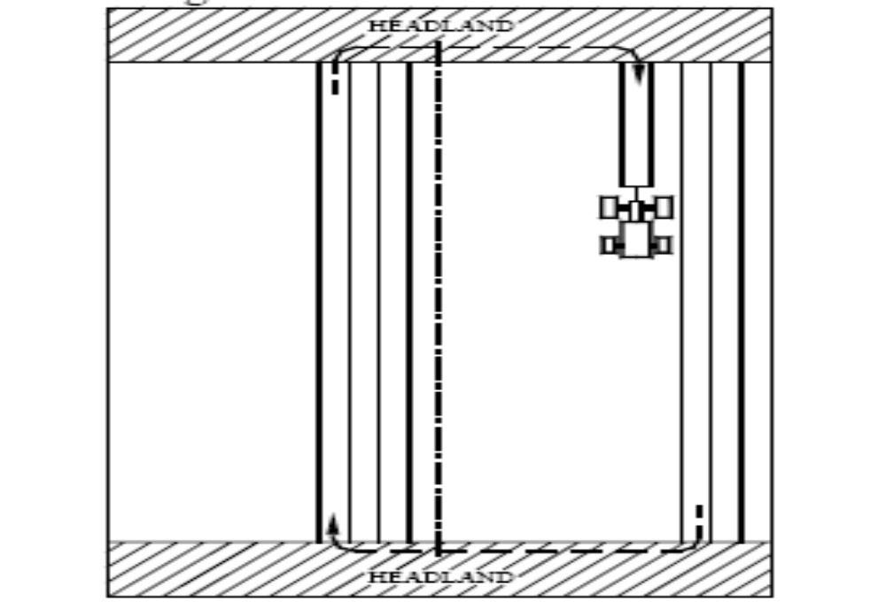
Operational Pattern

Slide 105
Traveling Speed
A traveling speed of 7 kph to 8 kph shall be maintained during the operation.

Slide 106
Test Trials
The test shall be conducted with at least three test trials. For each test trial, two passes perpendicular to each other shall be done. Test data shall be measured for each pass.

Slide 107
Headland
Depending on the tractor size, headland shall be at least 3 m in length.

Slide 108
Effective Working Width
Effective working width is determined by dividing the total width of the field by the number of passes.

Slide 109
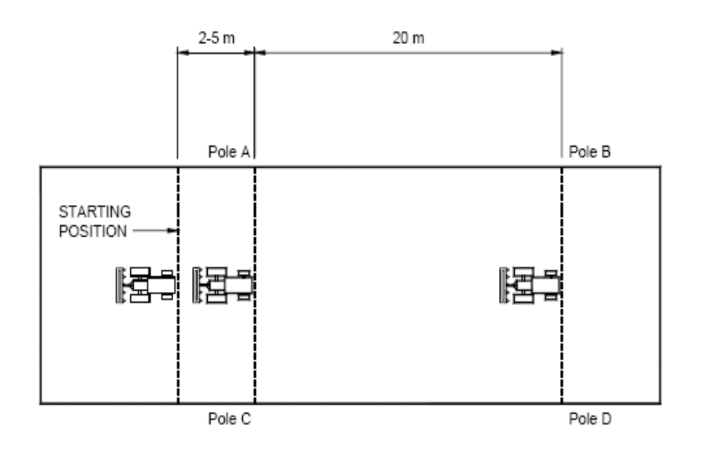
Verification of Operating Speed

Slide 110
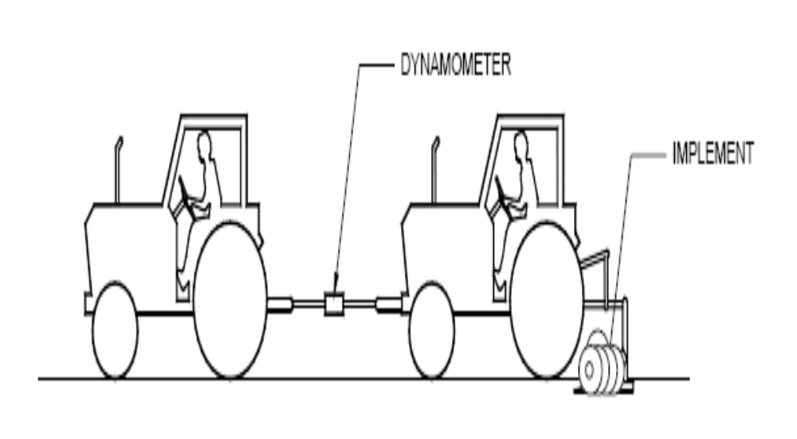
Power Requirement Determination

Slide 111
SMALL ENGINES

Slide 112
Compression ratio
CR = PD+V/V
Where:
PD = A x L
Where:
CR is the compression ratio
PD is the area of the cylinder, cm³
L is the length of a stroke, cm
V is the volume of combustion chamber

Slide 113
Varying load test
Output power, P_{o}, (kW)
P_{o} = T x N/974
Where:
T is the shaft torque, kg-m
N is the shaft speed, rpm

Slide 114
Fuel consumption, F_{c}, (L/h)
F_{c} = V/t
Where:
V is the volume offuel consumed

Slide 115
Specific fuel consumption< SFC, (g/kW-h)
SFC = F_{c} x ρf/P_{o}
Where:
Fc is the fuel consumption, L/h
p_{f is the density of fuel, g/l}
P is the axle or rotary shaft power

Slide 116
Corn Sheller
machine used to detached, separate, and clean the corn kernels from the cob.

Slide 117
Major steps of a corn sheller
Feeding the ear to the shelling unit.
Shelling and re-shelling the kernels from the cob.
Separating the kernels from the cob.
Cleaning and collecting the kernels.

Slide 118
Principal Units
Conveying unit
Shelling unit
Cleaning unit
Handling unit

Slide 119
Conveying unit
As the ears fall from the snapping or husking rolls, they are conveyed back and elevated so they can be dropped either through an air blast into the wagon elevator into the husker or Sheller units.

Slide 120
Shelling unit
The shelling unit generally consists of a beater or cylinder, operating over a concave made from round bars or from a perforated metal sheet. The kernels are removed from the cobs by the action of the beater in agitating and moving the ears over the concave. The kernels fall through the concave as the cobs and the husks are moved axially through the shelling unit by the spiral arrangement of the cylinder elements.

Slide 121
Cleaning unit
Cleaning is accomplished by a mechanical trash ejector and by air blast. Ejecting rolls and augers remove trash and husks from the husking rolls and discharge it
to the ground.
The air blast from the fan strikes the ear as they leave the husking rolls; in some models the air blast plays on the husking rolls. The strength of this air blast can be adjusted as needed, to blow off loose husks, leaves, pieces of stalks and other trash.

Slide 122
Handling unit
This power driven unit conveys the shelled, cleaned kernel to the point at which it is taken from the combine. It includes these parts: clean grain auger; clean grain elevator; and grain tank and tank unloader, or bagger and bag chute.
The clean grain auger collects the clean grain at the bottom of the shoe and conveys it across the combine to the elevator.
The clean grain elevator extends upward along one side of the combine. It elevates grain from the auger and discharges it into the grain tank or bagger.

Slide 123
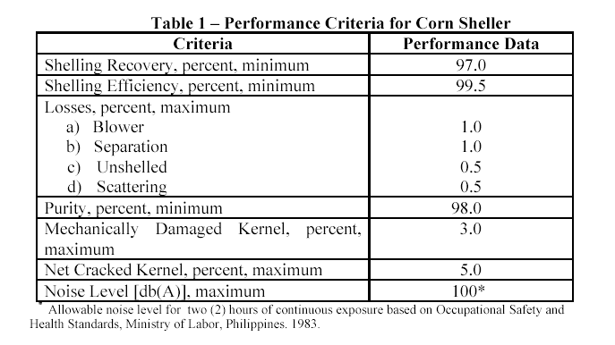

Slide 124
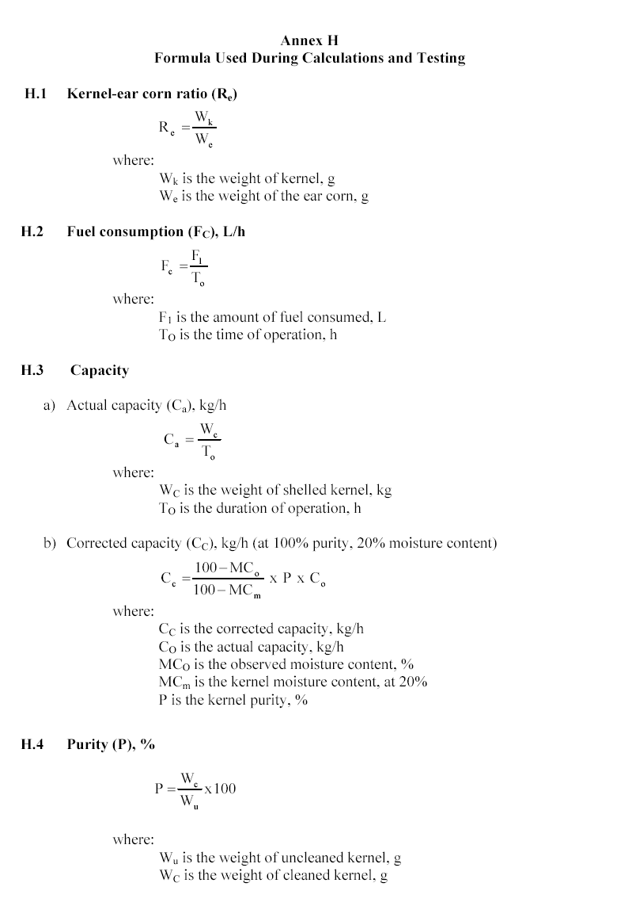

Slide 125
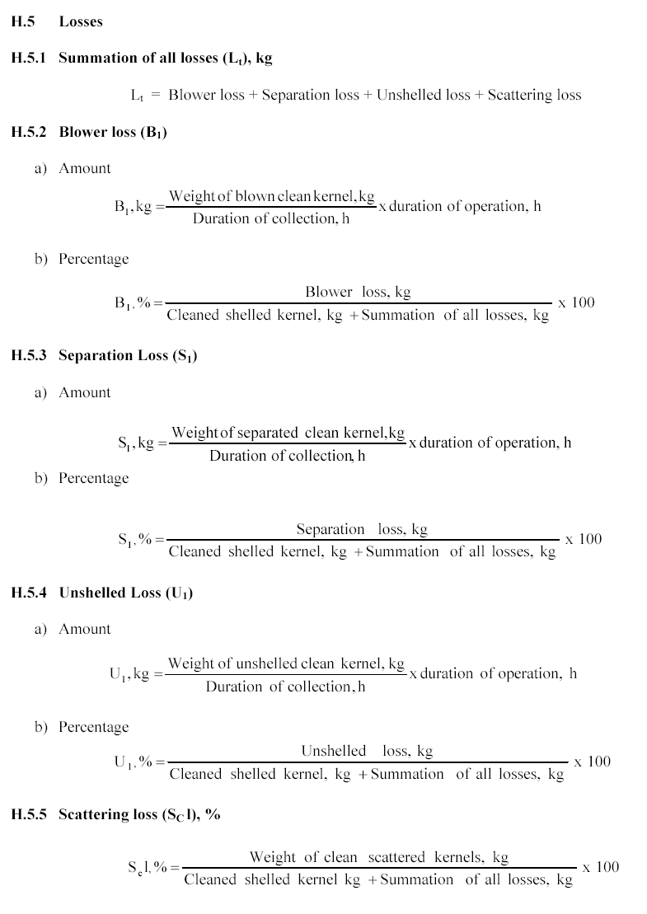

Slide 126
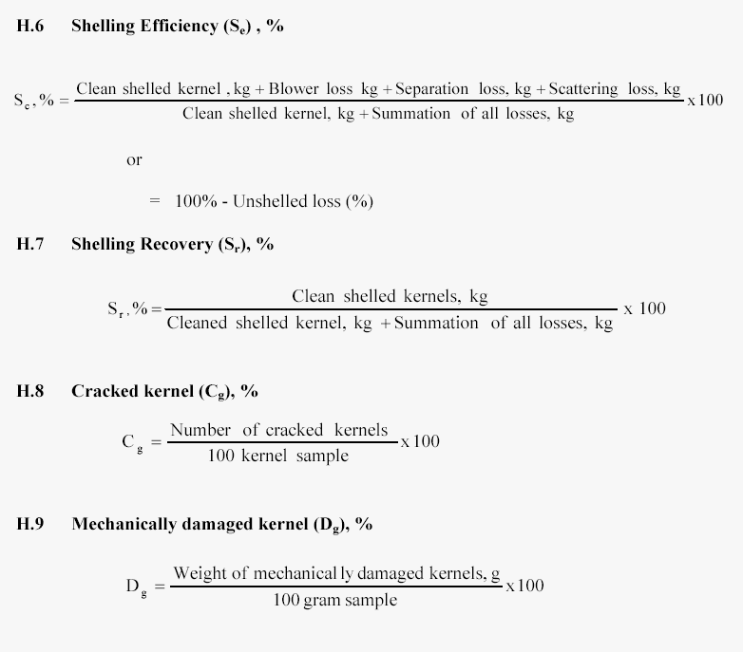

Slide 127
DEFINITIONS
drilling rig - structural assembly which is used to drill holes for the purpose of water-well construction
drilling pipe - serves as an adaptor of the drill bit and conduit of water jet channel

Slide 128
drill bit - bit attached to the end of the drilling pipe which is directly in contact with the soil formation and serves as cutting device during drilling operation
main rig assembly - structure which supports the entire drilling system
surging stem - jetting stem light weight pipes used during high velocity flow (jetting) operation

Slide 129
TYPICAL DRILLING RIG DESIGNS AND ITS MAIN COMPONENT

Slide 130
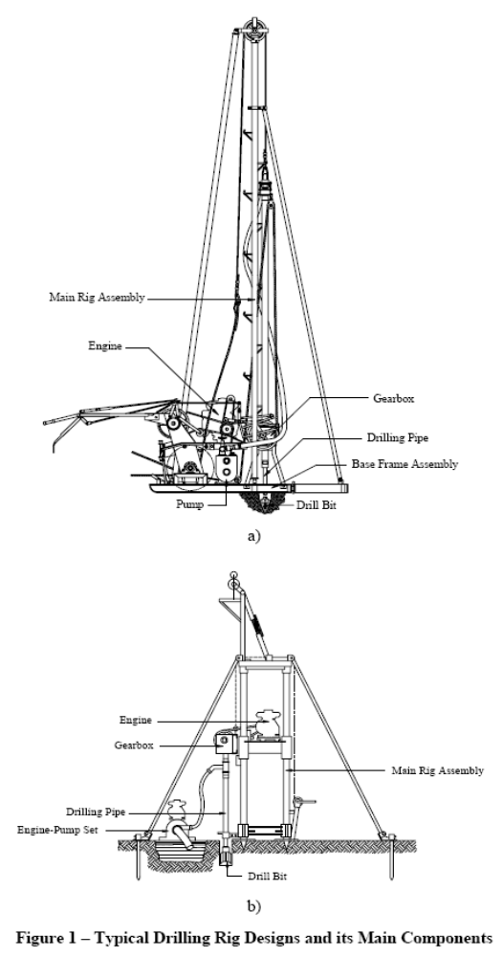

Slide 132
CLASSIFICATION
1. Rotary
2. Percussion
3. Combination

Slide 133
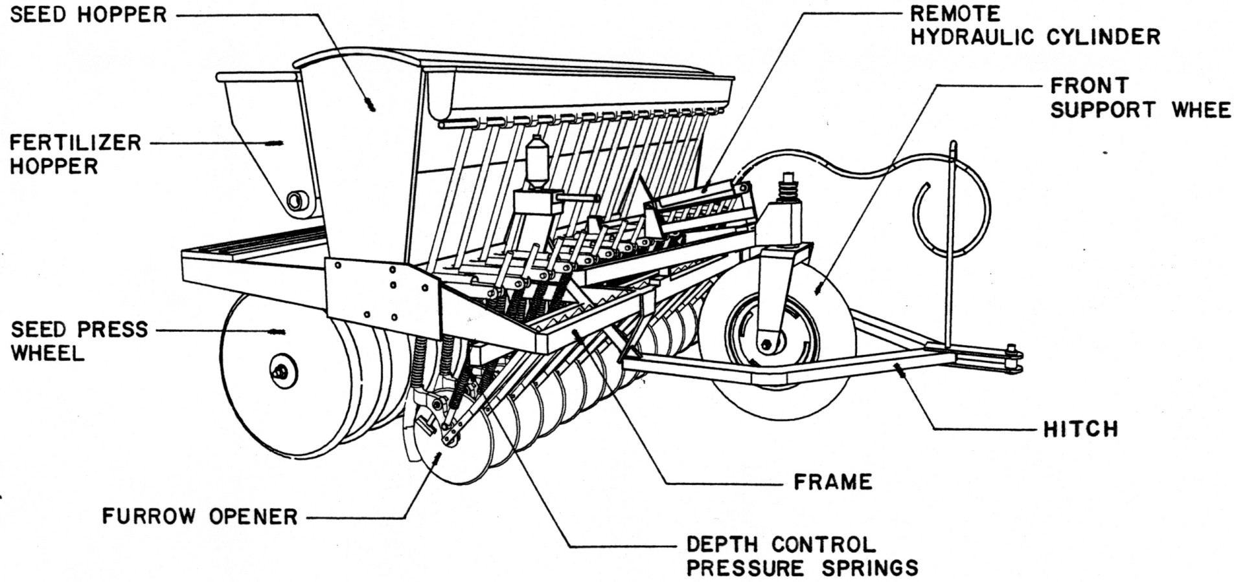
Classification of fertilizer applicator
Based on fertilizer distribution
1. Row fertilizer Applicator
Figure1- Row fertilizer Applicator
Notes:
Figure1- Row fertilizer Applicator

Slide 134

2. Broadcaster
Figure 2- Broadcaster
Notes:
Figure 2- Broadcaster

Slide 135
Based on power source
Animal - drawn
Manually-operated
3 Tractor-drawn
3.1 Two-wheel tractor-drawn
3.2 Four-wheel tractor-drawn

Slide 136

Based on metering device
    Star-wheel
Figure 3 – Star-wheel Type

Slide 137

Revolving-bottom type
Figure 4 – Revolving Bottom Type

Slide 138



Granular fertilizer type
a. Neoprene Fluted Roll
b. Vane-type Short Rotor over each Opening
c. Full-length Vane-type Rotor
Figure 8 – Granular pesticide Type

Slide 139


Formulas Used During Calculation and Testing
E1 Field Performance Test
E1.1 Delivery Rate
E.1.1.1 Nominal working width, W, (m)
W= n x d_{r}
where: W is the nominal working width, m
n is the number of rows
d_{r} is the row spacing, m
E.1.1.2 Ground wheel-driven machine
E.1.1.2.1 Effective diameter of ground wheel under load
D_{e} =
where: D_{e} is the effective diameter, m
N is the number diameter, m
d is the distance for a given N, m
E1.1.2.2 Delivery Rate
Q=
where: Q is the delivery rate, kg/ha
L is the delivery for a given N, kg

Slide 140



E1.1.2 PTO-driven machine
Q=
where: Q is the delivery rate ,kg/ha
L is the delivery for a given N, kg
v is the tractor speed, m/s
t is the time for measuring delivery, s
E1.2 Effective Field Capacity, efc, (m²/h)
efc =
where: A is the area covered, m²
t is the time used during the operation, hr
E1.3 Theoretical Field Capacity, tfc, (m²/h)
tfc=
where: s traveling speed, m/s
E1.4 Field efficiency,f, (%)
f = X 100
where: efc is the effective field capacity, m2/h
tfc is the theoretical field capacity m2/h
d distance travel (length of the field multiplied by the
number of passes), m

Slide 141



E1.5 Fuel Consumption, FC, (L/h)
FC =
where: V is the volume of fuel consumed, L
t is the total operating time, h
E1.6 Standard Deviation, STDV
STDV=
where: STDV is the standard deviation
n is the number of samples
x is the weight of sample
E1.7 Coefficient of Variation, CV
CV=
where: AVE average of the collected fertilizer

Slide 142
Furrower
Tillage implement resembling a double moldboard, one left wing and one right wing (see Figure 1), used to make ridges and beds for planting and trenches for irrigation and drainage purposes.

Slide 143
Furrow
Trench is formed after the furrower bottom cut and turned the furrow slices.

Slide 144
Furrowing
Tillage and land-forming operations using the furrower that lifts inverts and throws laterally the layer of soil (furrow slice) in opposite directions.

Slide 145
Furrower bottom
Lister bottom is the working part of the furrower that includes the share and moldboard.

Slide 146
Blackland bottom
Bottom that has smaller moldboards and is designed for better scouring in sticky soils (see Figure 2a).

Slide 147
General-purpose bottom
Bottom that has wider moldboards that works well at high speeds in most soil conditions (see Figure 2b).

Slide 148
Hard-ground bottom
Bottom that has very small share and moldboard designed for use in combination with disc openers to open hard-baked soils (see Figure 2c).

Slide 149
Hitch
Part of an implement designed to connect to the tractor.

Slide 150
Moldboard
Part of the furrower that lifts inverts and throws laterally the layer of soil (furrow slice) in opposite directions.

Slide 151
Row marker
Toolbar mounted device used to guide the operator in setting the furrower for the next pass to ensure uniform furrow spacing.

Slide 152
Share
It is a part of the furrower that penetrates the soil and cuts the furrow slice horizontally.

Slide 153
Standard
Beam leg is the upright support, which connects the furrower bottom to a toolbar.

Slide 154
Toolbar
Structure to which the standards are mounted.

Slide 155
Size
The size of the furrower bottom shall be determined by measuring the horizontal distance from the left to the right wings of share (See Figure 2).

Slide 156

Figure 2 – Size of the Furrower Bottom

Slide 157

Operational Pattern
Recommended Field Operational Pattern

Slide 158
Traveling Speed
  A traveling speed of 7 kph to 8 kph shall be maintained during the operation.

Slide 159
Headland
  Depending on the tractor size, headland shall be at least 3 m in length.
Effective Working Width
  Effective working width is determined by dividing the total width of the field by the number of passes.

Slide 160

Depth of Furrow
Measurement of Depth of Furrow

Slide 161

Measurement of Operating Speed

Slide 162
Wheel Slip or Travel Reduction
  The tractor drive wheel is marked with colored tape. For a given distance, the number of revolutions of the driving wheels with load (N1) and without load (N0) shall be recorded. (refer to Annex E for the formula used in calculating wheel slip).

Slide 163

Figure 4 – Draft Measurement

Slide 164

The power is calculated using the following formula:
Where:
P is the power requirement of the implement, kW
D is the draft of the implement, kg
v is the speed of the tractor, m/s

Slide 165


Slide 166
RICE COMBINE HARVESTER

Slide 167
MECHANISM
The mechanism included in a combine accomplishes five general functions.

Slide 168
CUTTING
The cutting operation is accomplished with a cutter bar and a reel. A pickup can be effective in lifting lodged crops above the cutter bar. A floating cutter bar is loosely beneath the combines header and flexes to follow the contour of the ground.

Slide 169
FEEDING
The feeding operation consists of mechanisms that distribute and deliver the crop material to the cylinder in a steady, uniform flow. Large – diameter augers convey the cut material away from the cutter bar to a central feeder drum which directs the material into a slatted conveyor. This conveyor delivers the material to the cylinders feeder beater.

Slide 170
THRESHING
The threshing operation is accomplished with a cylinder working against concaves. Three distinct mechanisms are used:

Slide 171
SEPARATING
The separation of the straw and grain occurs between the concaves bars, below the beater and straw rack. The grain is directed to the grain pan, which is usually positioned under the forward portion of the straw rack behind and below the cylinder.

Slide 172
CLEANING
The combine cleans grain in any or all the following ways.
  By screening out the larger particles with the chaffer and sieves.
  By blowing out the lighter particle with a fan blast.
  By screening out the smaller particles in a recleaner.

Slide 173
Classification
Self-propelled
Wheeled type
Track type
Tractor-operated

Slide 174

a. Wheeled type
a. Wheeled type

Slide 175

b. Track type

Slide 176
Materials of Construction
Stainless steel, alloys or abrasion-resistant coated metals shall be generally used for the manufacture of the different components of the rice combine.
Cutting elements (i.e. knife) should be made of either AISI 1080 to AISI 1085 or AISI 5160 or its ISO equivalent.
The serrated portion of the cutting knife should be case hardened at RC 46 to RC 52 for AISI 1080 to AISI 1085 (see Figure 2). The non-hardened portion of the cutting knife shall have hardness within the range of RC 25 to RC 27.

Slide 177
Threshing elements shall be made of alloy steel, or heat-treated carbon steel with carbon content of 40 % - 45 % (i.e. AISI 1040 to AISI 1055 or its ISO equivalent).
Bolts and screws to be used shall conform with the requirements of PAES 311 and PAES 313.

Slide 178
Table 1 - Performance criteria for rice combine
Criteria | Performance Data
Field efficiency (%), minimum | 75
Header loss (%), maximum | 0.5
Separation loss, (%), maximum | 1.3
Blower loss, (%), maximum | 1.2
Unthreshed loss, (%), maximum | 0.2
Scaterring loss, (%), maximum | 0.3
Total machine loss (%), maximum | 3.5
Purity (%), minimum a. with sifter and fan b. without sifter and fan c. without cleaning devices | 97.0 95 80
Mechanically damaged grain (%), maximum | 2.0
Net cracked grain (%), maximum | 5.0
Noise level, db(A), maximum | 95.0*
* Allowable noise level for four (4) hours of continuous exposure based on Occupational Safety and Health Standards, Ministry of Labor, Philippines. 1983.

Slide 179
Design Requirements
Cutting unit
Feeding unit
Threshing unit
Separating unit
Cleaning unit
Straw handling unit
Grain handling unit
Cab or frame
Traction aid

Slide 180
Formulas to be used:
A. Average swath or effective width of cut, S, (m)
S = W/2n
Where:
W = width of plot
N = number of rounds
2 = number of trips per round

Slide 181
B. Effective area accomplished, Ae, (m2)
Ae = 2n x L x S
C. Effective field capacity. Efc, (m2 /h)
Efc = 60 Ae/t
Where:
t = total time of operation

Slide 182
D. theoretical field capacity, tfc, (m2 /h)
tfc = wt x v
where:
wt = theoretical width, m
v = speed of operation, kph
E. Field efficiency, Feff. (%)
Feff.= ( Efc/ tfc )x 100

Slide 183
F. Grain losses
F.1 Pre – cut losses, H(%)
H = ((Wg_{T}/Wg_{O})/Yg) X 100
Where:
Wg_{T} = average weight of losses grain, g/m2
Yg = yield, g/m2
Wg_{O}= wt of grain on the ground before harvesting, g/m2

Slide 184
F.2 Conveying losses, C (%)
C = (Cg /Yg) x 100
Where:
Cg = weight of loose grain and grain from cut ears fallen outside cutting width, g/ m2
F.3 Miscellaneous losses, M (%)
F.4 Total machine losses, T (%)
T = H +C + M

Slide 185
G. Purity. P (%)
P = ( Wi / Wt ) x 100
Where:
Wi = weight of impurities or materials other than grain
Wt = total weight of grain samples
H. Damaged grains, D (%)
D = ( Wd/ Wt ) x 100
Where:
Wd = Weight of damage grains

Slide 186
Sprinkler Head
Base pressure - pressure measured at a point on the riser with a distance of at least five times the nominal sprinkler inlet diameter from the last upstream direction change or change in pipe cross sectional area
Nozzle - aperture of the sprinkler head through which the liquid is discharged

Slide 187
Radius of throw - farthest distance measured from the sprinkler head centerline to a point at which liquid is deposited
Rotating sprinkler head - rotating sprinkler device which by its rotating motion around its vertical axis distributes liquid over an area

Slide 188


Slide 189
    Table 1. Sprinkler Nozzle Height Above Collectors
Sprinkler Type | Sprinkler Inlet Size (Nominal Type Diameter) | Maximum Nozzle Height Above Collector
Riser mounted; rotating | 32 mm or smaller | 915 mm
Riser mounted; rotating | 38 mm or larger | 1830 mm
Riser mounted; non-rotating | All | 460 mm

Slide 190
Table 2. Maximum Spacing of Collectors for Pre-determined Sprinkler Radius of Throw Sprinkler Radius of Throw
Sprinkler Radius of Throw (m) | Maximum Collector Spacing Center to Center (m)
< 3 | 0.30
3 – 6 | 0.60
6 – 12 | 0.75
> 12 | 1.50

Slide 191
Test and Inspection
1. Verification of the Manufacturer’s Technical Data and Information
2. Field Performance Test
        Discharge Capacity Determination
        Q = V / T
        where: Q = is the discharge, L/s
        V = is the volume of liquid introduced into container in t seconds, L
t = is the time required to introduce liquid of volume V, s

Slide 192

      Radius of Throw Determination and Sprinkler’s Speed of Rotation

Slide 193


Slide 194


Slide 195


Slide 196
Hitch For Agricultural Tractor Classifications
One- hole hitch
Three- hole hitch

Slide 197

Dimensions and Tolerance

Slide 198


Slide 199

Hitch Pin

Slide 200

Dimensions
Hexagonal
Axle

Slide 201

slip
Belt slip

Slide 202
Where:
N0 is the sum of the revolutions of all driving wheels for the
same distance without load, rpm
N1 is the sum of the revolutions of all driving wheels for a
given distance with load, rpm

Slide 203
Average swath or width of cut, S, (m)
S=W/2n
Where:
W is the width of plot, m
n is the number of rounds
2 is the number of trips per round

Slide 204
Total distance traveled, D, (m)
A = L x W
Where:
A is the area of plot, m2
L is the length of the plot, m

Slide 205
Effective area accomplished, Ae, (m2)
Ae = wD = 2nLw
Where:
w is the width of plow or rotary tiller, m

Slide 206
If width of swath is less than the plow’s or rotary tiller’s width, the operator has passed over part of the area twice to secure better coverage, therefore:
Ao = Ae - A
Where:
Ao is the overlap (area which is plowed or rototilled twice), m2

Slide 207
If the average width of swath is greater that the plow’s or rotary tiller’s width, the operator has left part of the area unplowed or unrototilled, therefore:
Au = A - Ae
Where:
Au is the unplowed or unrototilled area (area missed), m2

Slide 208
Effective field capacity, efc, (m2/h)
Where:
t is the time used during the operation, min

Slide 209
Theoretical Field Capacity, tfc, (m2/h)
tfc=we x v
Where:
we is the effective or theoretical width of tillage, m
v is the speed of operation, m/h

Slide 210
Field Efficiency, Feff, (%)

Slide 211
Fuel Consumption, FC, (L/h)
Where:
V is the volume of fuel consumed, L
t is the total operating time, h

Slide 212
Axle/Rotary Shaft Torque, T, (kg-m)
T= F x L
Where:
F is the axle or rotary shaft load, kg
L is the length of pony brake arm, m

Slide 213
Axle/Rotary Shaft Power, P, (kW)
Where:
Ft is the total axle or rotary shaft load, kg
N is the speed of axle or rotary shaft, rpm

Slide 214
definitions
Mechanical Rice Thresher
axial flow thresher
throw-in type of thresher which allows the cut plants to move in a helical manner around the threshing cylinder with a net effect of moving the material axially between the feeding and discharge outlets
blower loss
ratio of the weight of grains blown with the chaff by the thresher fan, to the weight of the total grain input of the thresher, expressed in percent

Slide 215
chaff
empty grains and crushed straw being discharged from the threshing chamber
concave grate
concave component iron grill frame partially or fully surrounding the cylinder on which the threshing elements, rubs, shear and/or impact the cut plants
cracked grains
grains which show signs of fissures or fractures or splinters

Slide 216
grain-straw ratio
grain content ratio of the weight of the grains present in the panicles, to the total weight of the grain and straw in the same sample
hold-on thresher
type of thresher wherein the panicles of the while the stalks are mechanically or manually held during the threshing operation
mechanically damaged grain
grains that were broken and/or dehulled (partially or fully) as a result of threshing operation

Slide 217
mechanical rice thresher
machine used to detach and separate the palay from the panicles
NOTE: It may or may not have a grain cleaning unit.
moisture content
amount of moisture in the grain expressed as percentage of the total weight of the sample (wet basis)

Slide 218
It is calculated as:
Moisture Content, % w.b.= Mo – M1 x 100
M1
Where:
Mo = initial mass in grams of the test portion
M1 = mass in grams of the dry test portion

Slide 219
palay
paddy
rice
rough rice
unhulled grain of Oryza sativa L., that is, grain with the hull/husk
peg-tooth cylinder
type of threshing cylinder wherein spikes or pegs are attached on the periphery of the cylinder in tandem or in helical arrangements

Slide 220
purity
ratio of the weight of clean grains, to the total weight of unclean grains sample, expressed in percent
rasp-bar cylinder
type of threshing cylinder wherein threshing is done between bar-like protrusions in parallel orientation laid on the periphery of the cylinder and stationary bars built into or attached to the concave grate
rated engine speed
engine speed indicated in revolutions per minute (rpm) of the engine shaft as specified by the engine manufacturer for operation at nominal continuous load

Slide 221
scattering loss
ratio of the weight of grains that fell out from the machine during threshing operation, to the weight of the total grain input of the thresher, expressed in percent
separation loss
ratio of the weight of grains that come out of the threshing chamber with the straw, to the weight of total grain input of the thresher, expressed in percent
straw length
cut plants length measured from the point of cut to the tip of the panicle

Slide 222
threshed grain
grains that are detached from the panicles by the thresher inclusive of mature, immature, and damaged grains
threshing unit
threshing chamber part of the thresher where the grains are detached and separated from the panicles
threshing cylinder
threshing drum part of the threshing unit that rotates about an axis and it is equipped with either pegs, rasp bars, or wire loops on its periphery

Slide 223
threshing efficiency
ratio of the weight of the threshed grains collected at all outlets
threshing element
attachments of the threshing cylinder such as peg tooth, wire-loop and rasp-bar that detaches the grains from the panicles
threshing recovery
ratio of the weight of the threshed grains collected at the main grain outlet, to the weight of the total grain input of the thresher, expressed in percent

Slide 224
through flow thresher
throw-in type of thresher wherein cut plants are fed between the rotating cylinder and stationary concave and the threshed materials/straws are discharged out of the threshing chamber tangentially
throw-in thresher
type of thresher which detaches the grains by feeding the cut plants into the machine
total grain input
sum of the weights of collected threshed grains and all grains loss during threshing

Slide 225
unthreshed loss
ratio of the weight of grains that remained in the panicles of the plants fed into the threshing chamber, to the weight of total grain input of the thresher, expressed in percent
wire-loop cylinder
type of threshing cylinder wherein wires of the same arc and size are attached on the periphery of the cylinder in tandem arrangement with or without the threshing

Slide 226
The classification of mechanical rice thresher shall be based on the following:
Method of feeding
Hold-on type
Throw-in type
Operation
Axial flow type
Through flow type
Threshing cylinder
Peg-tooth cylinder
Rasp-bar cylinder
Wire-loop cylinder

Slide 227
Performance Criteria for Mechanical Rice Thresher.
Criteria Performance Data
Threshing Recovery, percent, minimum 97.0T
hreshing Efficiency , percent, minimum 99.8
Losses, percent, maximum
a) Blower Loss 1.2
b) Separation Loss 1.3
c) Unthreshed Loss 0.2
d) Scattering Loss 0.3
Purity, percent, minimum
a) With Sifter and Fan 97.0
b) Without Sifter and With Fan 95.0
c) Without Cleaning Devices 80.0
Mechanically Damaged Grain, percent, maximum 2.0
Net Cracked Grain, percent, maximum 5.0
Noise Level, [db(A)], maximum 95.0*
* Allowable noise level for four (4) hours of continuous exposure based on Occupational Safety and Health Standards, Ministry of Labor, Philippines. 1983.

Slide 228

basic way of pump operation
WATER PUMP(CENTRIFUGAL PUMP)

Slide 229
TYPES OF PUMPS
Centrifugal Pumps: True centrifugal pumps were not developed until the late 1600's, when Denis Papin, a French born inventor, made one with straight vanes. The curved vane was introduced by British inventor John G. Appold in 1851. Centrifugal pumps are inexpensive and can handle large amounts of fluid.

Slide 230

There are several kinds of centrifugal pumps including radial-flow, mixed-flow, and axial flow.

Slide 231
Electromagnetic Pumps: They consist of electrical conductors and magnetized pipes. These conductors send current through the fluid. The fluid is then moved by the magnetic attraction and repulsion between the fluid's magnetic field and the magnetic field of the pipes.

Slide 232

Jet Pumps: They operate on the principle that high-velocity fluid will carry along any other fluid it passes through. Jet pumps can be used to raise water from wells that are deeper than 200 feet.

Slide 233
Screw Pumps: These is also known as positive-displacement pumps. It was based on the Archimedes screw principle. This has two very evident advantages (1) it can pump large solids without clumping, (2) it operates at a constant speed over a wide range of flows with good efficiencies.

Slide 234
Other Pumps:
Rotary pump are used to pump viscous liquids like motor oil, syrup, and paint. There are three main types of rotary pumps including: (1) gear pumps, (2) lobe pumps, (3) sliding vane pumps.
Reciprocating pumps consist of a piston that moves back and forth within a cylinder. Common reciprocating pumps are lift pumps, force pumps, and bicycle tire pumps.

Slide 235

Centrifugal Pumps

Slide 236
Advantages
High efficiency over a range of operating conditions.
Easy to install.
Simple, economical and adaptable to many situations.
Electric, internal combustion engines or than design value, the tractor power can be used.
Does not overload with increased TDH.
Vertical centrifugal may be submerged and not need priming.

Slide 237
Disadvantages
Suction lift is limited. It needs to be within 20 vertical feet of the water surface.
Priming required.
Loss of prime can damage pump.
If the TDH is much lower than design value, the motor may overload.

Slide 238
kinds of centrifugal pumps
Radial flow pumps are centrifugal pumps in which the pressure is developed wholly by centrifugal force.
In mixed flow pumps, the pressure is developed partly by centrifugal force and partly by the lift of the vanes of the impeller on the liquid.
Axial flow centrifugal pumps develop pressure by the propelling or lifting action of the vanes of the impeller on the liquid.

Slide 239

Stuffing Box - A : :
Packing - B : :
Shaft - C : :
Shaft Sleeve - D : :
Vane - E : :
Casing - F : :
Eye of Impeller - G : :
Impeller - H : :
Casing wear Ring - I : :
Impeller - J : :
Discharge Nozzle - K :

Slide 240
Method of priming
Non-self-priming
Non-self-priming pump is one that needs to be manually primed.
Self-priming
Self-priming pump is one that develops a vacuum sufficiently enough for atmospheric pressure to force the liquid to flow.

Slide 241
Performance Requirements
Performance curve, which shows the head, efficiency, NPSHR, and the power, plotted against discharge at specified shaft speed, shall be provided.
The capacity and total head at maximum efficiency and rated shaft speed, as claimed by the manufacturer shall be attained.

Slide 242
Other Requirements
The centrifugal pump shall be designed for easy maintenance.
The rotating components shall be dynamically balanced.
Radial bearings shall be of standard available design
The pump shall be designed to permit removal of the impeller, shaft seal and bearing assembly without disturbing the inlet and outlet flange connection.

Slide 243
Sealed type bearing shall be used or the bearing housing shall be sealed
Bearing housing shall preferably be arranged
Shafts shall be of ample size and of appropriate stiffness

Slide 244
Definitions
Axial flow pump
Base plane
Cavitation
Centrifugal pump
Discharge
Friction head, hf
Head
Mixed flow pump
Net positive suction head-NPSH (hsv)
Net positive suction head available (NPSHA)

Slide 245
Net positive suction head required (NPSHR)
Performance curve
Pump
Priming
Pump efficiency
( çp )
Shaft power
Static discharge head
( hd )
Static suction head
( hs )
Static suction lift
( hs )
Total discharge head (Hd)
Total head (TH)
Total suction head
( Hs )
Total suction lift ( Hs )
Velocity head (hv)
Water power

Slide 246
Materials and Equipment
Water
The water to be used during the test shall be clean with a temperature range of 10 – 40 ºC.
Measuring Instruments
dynamometer
gauges
weighing tank
weir, venturi, nozzle, orifice plate and Pitot tube

Slide 247
Performance Test
The test shall be conducted by operating the pump at manufacturer’s recommended speed. The discharge and total head shall be varied by regulating the valve on the discharge side. In the case of pump to be tested in actual site, the actual measurements of the ff. shall be obtained:
  Static suction lift
  Static discharge head
  Size and length of the pipes from coupling
  Number of bends of piping

Slide 248
.
The following curves shall be presented:
Total head vs. Discharge
Pump input power vs. Discharge
Efficiency vs. Discharge
Pump Speed vs. Discharge
NPSH vs. Discharge

Slide 249
Priming Test
The pump shall be mounted on a test set-up with a static lift between the eye of the impeller and the water level of at least 3 m.
No check or foot valves shall be installed in the suction piping.
Before operation, fill the priming chamber with water at a temperature range of 10 – 40 ºC.

Slide 250
MASONRY

Slide 251


Concrete
It is an artificial stone as a result of mixing cement, fine aggregate, coarse aggregate, and water.
Classifications:
  Plain concrete – solid mass of mixture of cement and aggregates.
  Reinforce concrete – a concrete wherein a reinforcement bars are embedded to act together as a resisting forces.

Slide 252


Slide 253


Cement
Hydraulic Cement - is a bonding agent that reacts with water to form a hard stone-like substance that is resistant to disintegration in water.
Portland Cement – is widely used in various small and large construction including roads and highways. It is a type of hydraulic cement.

Slide 254
Aggregates
Inert materials when bound together into a conglomerated mass by Portland cement and water form concrete, mortar, plaster.
Classifications:
  Coarse Aggregate – portion of aggregates that is retained on number 4 sieve (4.76 mm)
  Fine Aggregates – are sand that passes through no. 4 sieve predominantly retained by no. 200 sieve.

Slide 255


Course Aggregates
Fine Aggregates

Slide 256





Slide 257
Concrete Proportioning
Class | Proportion | Cement Bags/m³ | Sand Per m³ | Gravel Per m³
AA | 1 : 2 : 3 | 10.50 | 0.42 | 0.84
A | 1 : 2 : 4 | 7.84 | 0.44 | 0.88
B | 1 : 2.5 : 5 | 6.48 | 0.44 | 0.88
C | 1: 3 : 6 | 5.48 | 0.44 | 0.88
D | 1 : 3.5 : 7 | 5.00 | 0.45 | 0.90
Using 94 lbs Portland cement

Slide 258
Estimating Concrete Requirement
Vol of Conc = W (m) x L (m) x T (m)
No of Bags of Cement = Vol of conc x Factor for cement
Volume of Sand = Vol of conc x Factor for sand
Volume of Gravel = volume of conc x Factor for gravel
Factors for various mixing proportions are given above

Slide 259

A sundrying floor made of concrete is to be constructed. The area of the floor will have a dimension of 20 ft wide and x 40 ft long. The thickness of the floor is proposed to be 4 inches. If concrete mixture of 1:2:4 will be adopted for the construction, how much is the number of bags of cement that will be needed to finish the job. What is the estimated cubic meter of sand and gravel that will be needed?
Given:
Width - 20 ft
Length - 40 ft
Thickness - 4 in.
Mixing proportion - 1:2:4
Required: No. of bugs of cement, and volume of cement and sand

Slide 260
Solution:
Volume of concrete = 20 ft x 40 ft x 4 in /12 in/ft
= 266.67 ft³ x (1m3/(3.28 ft) ³)
= 7.56 m³
No. of bags of cement = 7.84 bags/m³ x 7.56 m³
= 59.27 bags
Volume of sand = 0.44 m³ sand/m³ concrete x 7.56 m³
= 3.33 m³
Volume of gravel = 0.88 m³ gravel/m³ concrete x 7.56 m³
= 6.65 m³

Slide 261

Compute the volume of concrete required for an engine foundation of a rice mill. The engine is a Mitsubishi 4DR5 with a gross weight of 650 kg. Engine will be operated at a speed of 2000 rpm. Assume concrete density of 2,406 kg/m3.
Given: Wt of engine - 650 kg
Engine speed - 2000 rpm
Density of Concrete - 2,406 kg/m3
Required: Weight of foundation, and Volume of concrete foundation
Solution:
Wf = ε We [ N ] 0.5
= 0.11 (650 kg) ( 2000 rpm ) ^{0.5}
= 3,197.58 kg
Vf = Wf / dc
= 3,197.58 kg / 2,406 kg/m³
= 1.32 m³

Slide 262
What will be the depth of the concrete foundation above if the engine will have a base width and length of 1.0 and 1.5 meters, respectively? Consider an engine base allowance of 10%. If concrete mixture of 1:3:6 will be used for the foundation above, determine the number of bags of cement, and volume of sand and gravel needed.
Given: V - 1.32 m3
Width of engine base - 1.0 m
Length of engine base - 1.5 m
Engine base allowance - 10%
Concrete mixture - 1:3:6
Required: Depth of foundation, Number of bags
of cement
Volume of sand and gravel
Solution:
Df = Vf / [(We x Le) x allowance]
= 1.32 m3/ [(1.0 m x 1.5 m) 1.1]
= 0.72 m
No. of bags = 5.48 x 1.32 = 7.23 bags
Volume of sand = 0.44 x 1.32 = 0.58 m3
Volume of gravel = 0.88 x 1.32 = 1.16 m3

Slide 263

A sundrying floor is to be constructed using concrete. The dimension is 10 cm thick by 20 m wide and 30 m long. The recommended mixing proportion is 1:2:4. Determine the number of bags of cement and the volume of sand and gravel needed for the construction.
Given: Thickness - 10 cm
Width - 20 m
Length - 30 m
Mixing proportion - 1:2:4
Required: Number of bags of cement
Volume of sand
Volume of gravel
Solution: Vt = L x W x T
= 30 m x 20 m x 0.1 m
= 60 m3
Number of bags of cement = 7.84 bags/m3 x 60 m3
= 470 bags
Vol of sand = 0.44 m3/m3 con x 60 m3
= 26 m3
Vol of gravel = 0.88 m3/m3 con x 60 m3

Slide 264
Concrete Mixture
Type of Construction | Proportion
Side walk 4 in thick | 1 : 2 : 4
Floor Slab 4 in thick | 1 : 2 : 4
Wall | 1 : 2.5 : 5
Footing | 1 : 2.5 : 5
Post | 1 : 2.5 : 5
Machinery Foundation | 1 : 3 : 6
Reinforced Concrete | 1 : 2 : 4
Foundations | 1 : 2.5 : 5
Top Dressing | 1 : 2
Water Proofing | 1 : 2

Slide 265

Concrete Hallow Blocks
Standard sizes:
  4 in. x 8 in. x 16 in.
  6 in. x 8 in. x 16 in.
  8 in. x 8 in. x 16 in.
Rule of thumb: 13 CHB per square meter of wall area

Slide 266

Determine the number of hollow blocks needed for a wall having a height of 3 m from the ground and a perimeter length of 100 meters. Every 10 meters is a concrete post having a dimension of 12 in x 12 inches. The wall is protruded below the ground with 3 layers of hollow blocks. Also compute the number of bags of cement and sand needed for the mortar using a mixing proportion of 1:3.
Given: Height of wall - 3 m
Length of wall - 100 m
Post - 12 in. x 12 in per 10 m
Foundation - 3 layers of HB
Mortar - 1:3
Required:
Number of hollow blocks and number of bags of cement and
volume of sand for mortar joint

Slide 267
Solution:
Length occupied by post = 0.3 m/post x 10 post
= 3 m
Length of wall = 100 m – 3 m
= 97 m
Height of wall = 3 m + 0.2 m/CHB x 3 CHB
= 3. 6 m
Area of wall = 97 m x 3.6 m
= 349.2 m²
No. of CHB = 349.2 m2 x 13 CHB/m²
= 4,539.6 CHB
Volume of concrete = 4,539.6 CHB x 0.001 m³/CHB
= 4.57 m³
Bags of cement = 4.57 m3 x 12.04 bags/m³
= 54.10 bags of cement
Volume of sand = 4.54 m³ x 0.97 m³/m³
= 4.40 m³ of sand

Slide 268

Compute the number of 4” x 8” x 16” concrete hollow blocks needed for a wall having a length of 50 m and a height of 3 m. The wall is provided with a 0.4 m foundation wall.
Given: Length of wall - 50 m
Height of wall - 3 m
Height of foundation wall - 0.4 m
Required: Number of concrete hollow blocks needed for the wall
Solution:
Area of wall = (3 m + 0.4 m) 50 m
= 170 m2
No. CHB = 13 CHB/m2 x 170 m2
= 2,210 CHB

Slide 269


Compute the volume of 200 pieces mortar that can be contained in 4 in. x 8 in. x 16 in. concrete hallow block .
Given: Dimension - 4” x 8” x 16”
No. of CHB - 200 pieces
Required: Volume of mortar
Solution: Vol. of mortar = 200 pieces (0.001 m3/piece)
= 0.2 m3

Slide 270


Slide 271

Volume of Concrete per CHB
4 in. x 8 in. x 16 in. | 0.001 cubic meter
6 in. x 8 in. x 16 in. | 0.003 cubic meter
8 in. x 8 in. x 16 in. | 0.004 cubic meter

Slide 272
Plaster
Class | Mix | Cement (Bags) | Lime (Bags) | Sand (m³)
A | 1 : 2 | 8.5 | 8.5 | 0.90
B | 1 : 3 | 5.5 | 5.5 | 0.90
C | 1:4 | 4.5 | 4.5 | 0.90
Plaster volume per square meter = 0.012 cubic meter

Slide 273


Mortar
Proportion | 1:1 | 1:2 | 1:3 | 1:4 | 1:5 | 1:6
Cement | 24.08 | 16.24 | 12.04 | 9.44 | 7.88 | 7.60
Sand | 0.65 | 0.87 | 0.97 | 1.02 | 1.06 | 1.10

Slide 274
Bricks
They are manufactured from clay and other materials processed into a workable consistency molded to sizes and fired in a kiln to make them strong, durable, and attractive.
Classifications
  Common brick – ordinary commercial bricks
  Face brick - used in exposed exterior and interior masonry walls.
  Refractory bricks – for high temperature application

Slide 275


Slide 276
Other Masonry Materials
Ashlar – consist of carefully worked and joined stone blocks laid in parallel horizontal courses
Rubble Stone – generally consist of irregular stones with good face for the wall surface. The gaps between stones are filled with smaller or broken stones and cement mortar

Slide 277






Slide 278




Slide 279
WOOD

Slide 280
Introduction
Wood is one of the most common construction materials.
They are very difficult to classify, select, and use correctly due to the great variation in the properties of the different species and to the influence of defects in growth and seasoning.

Slide 281


Advantages of Wood
In proportion to weight, wood is stronger than other materials
Easily worked out with tools and fabricated into many shapes, sizes, and design.
Excellent non-conductor of heat.
Abundant is many shapes, color, sizes, and as renewable resources.
Does not deteriorate if properly handles and protected

Slide 282



Wood Properties
Strong material
Durable
Light in weight
Ease of working and fastening
With artistic and natural beauty

Slide 283


1. Soft Wood – It comes from the needle-leaved, cone bearing trees
2. Hard Wood – It Comes from the deciduous or broad leaf tree.
Classifications of Wood

Slide 284


Slide 285
Wood Defects
Compression Wood
Decay
Pitch Pocket
Shake
Mineral Streaks
Mold and Staining Fungi
Knots
Cross Grain

Slide 286

Wood Processing

Slide 287



Wood Surfaces
Face
End
Edge

Slide 288


Lumber
Lumber – term applied to wood after it was sawed or sliced into boards, planks, sticks, etc for commercial purposes.

Slide 289
Some Definitions
Surfaced or Dressed Lumber – is a planed lumber having at least one smooth side
S2S and S4S – planed or dressed lumber of which the number connotes the smooth side. S2S smooth on two sides while S4S smooth on four sides.
Rough Lumber - is the term applied to newly sawed lumber.

Slide 290



Timber – is a piece of lumber five inches or larger in smallest dimension.
Plank – is a wide piece of lumber from 2 to 5 inches thick
Board – is a piece of lumber less than 1-1/2 in thick and at least 4 inches wide
Flitch – is a thick piece of lumber
Slab - kind of rough lumber cut tangent to the annual rings of wood running the full length of the log and containing at least one flat surface.

Slide 291
Measuring Wood
Board Foot – it means the one square foot of wood one inch thick or 144 cubic inches.
Formula:
Bd-Ft = T(in) x W(in) x L(ft) / 12
Bd-Ft = T(in) x W(ft) x L (ft)/144
1 ft
1 ft
1 in.

Slide 292

Compute the total cost of 50 pcs-2 x 3 x 12 lumber at P27/bd ft.
Given: No. of pieces of lumber - 50 pieces
Size of lumber - 2” x 3” x 12’
Price per bd ft - P 27 / bd ft
Required: Total cost of lumber
Solution:
bd ft = (2” x 3” x 12”) 12
= 6 bd ft
total bd ft = 6 bd ft/piece x 50 pieces
= 300 bd ft
Total cost of lumber = (300 bd ft) ( P27 / bd ft)
= P8, 100

Slide 293

Determine the number of board foot of wood having the following dimension and number of stocks: (a) 40 pcs - 2 in. x 4 in. x 10 ft; (b) 120 pcs - 1 in. x 2 in. x 12 ft; (c) 500 pcs - 2 in. x 2 in x 8 ft; and (d) 20 pcs - 1 in. x 1 ft x 10 ft. Also compute the total cost of the stocks of wood if the cost per board foot is P30.00.
Given: Wood sizes and stocks 40 pcs - 2 in. x 4 in. x 10 ft
120 pcs - 1 in. x 2 in. x 12 ft
500 pcs - 2 in. x 2 in x 8 ft
20 pcs - 1 in. x 1 ft x 10 ft
Price per board foot - P30.00
Required: Total number of board foot and cost of the materials

Slide 294
Solution:
Bd-ft (A) = 2 in. x 4 in. x 10 ft /12
= 6.07bd-ft/pc x 40 pcs
= 266.67 bd-ft
Bd-ft (B) = 1 in. x 2 in x 12 ft / 12
= 2 bd-ft/pc x 120 pcs
= 240 bd-ft
Bd-ft (C) = 2 in x 4 in x 8 ft / 12
= 2.67 bd-ft/pc x 500 pcs
= 1,333 bd-ft
Bd-ft (D) = 1 in. x 1 ft x 10 ft / 144
= 0.869 bd-ft x 20 pcs
= 1.39 bd-ft
Total Bd-ft = 266.67 bd-ft + 240 bd-ft + 1,333 bd-ft + 1.39 bd-ft
= 1,841.06 bd-ft
Cost = 1,841.06 bd-ft x P30.00 /bd-ft
= P55,231.80

Slide 295


Lumber and Related Products
Veneer and Plywood – light in weight and strong. Thickness available from 1/8 to ¾ in. Standard length and width are 8 ft x 4 ft, respectively.
Types includes
  Soft plywood
  Harwood plywood
  Exterior or marine plywood

Slide 296


Hardboard – are pressed wood made from wood chips exploded into fibers under high pressured steam.
Particle Board – manufactured from wood chips, curls, fibers, flakes, strands, shaving, etc bound together and pressed into sheets and other molded shapes.

Slide 297
STEEL

Slide 298


Steel – is obtained from iron ore processed to form a metal. Reinforced steel bar (RSB), GI sheet roofing, C-purlins, and structural steels are examples of materials that is made of steel.

Slide 299
Steel Reinforcement
Vertical Spacing (m) | Length of Bar in meter per square meter | Horizontal Spacing in Layers | Length of bars in meter per square meter
0.40 | 2.93 | 2 | 3.30
0.60 | 2.13 | 3 | 2.15
0.80 | 1.60 | 4 | 1.72
Tie Wire: 20 kg of no. 16 wire per ton of reinforcement
bar and 35 kg per roll of wire

Slide 300

Corrugated Roofing Sheet
Size | 10 in. end lap and 2 in. corner side lap | 12 in. end lap 2 in. corner side lap
32 in x 6 ft | 1.03 sq.m. | 1.05 sq.m.
32 in x 7 ft | 1.29 sq.m. | 1.25 sq.m.
32 in. x 8 ft | 1.50 sq.m. | 1.46 sq.m.
32 in x 12 ft | 2.35 sq.m. | 2.30 sq.m.

